Slide 1

Y5 U8 Pre-Unit Quiz:
Diagnostic Questions and Response
Year 5 Spring 2
Unit 8
Fractions and percentages

Slide 2
Contents
Guidance on the Pre-Unit Quizzes
Overview of this unit:
Context of this Mathematics Mastery Unit
Prior learning, Pre-requisite concepts and Possible misconceptions
The Y5 U8 Pre-Unit Quiz and Response signpost: Teacher version
Q1: To convert between mixed numbers and improper fractions
Q2: To convert between mixed numbers and improper fractions
Q3: To identify equivalent fractions
Q4: To identify equivalent fractions
Q5: To add and subtract fractions within 1
Q6: To add and subtract fractions within 1
Q7: To calculate unit fractions of amounts
Q8: To calculate unit fractions of amounts
Q9: To identify hundredths
Q10: To identify hundredths
Q11: To compare fractions
The Quiz: Pupil version

Slide 3
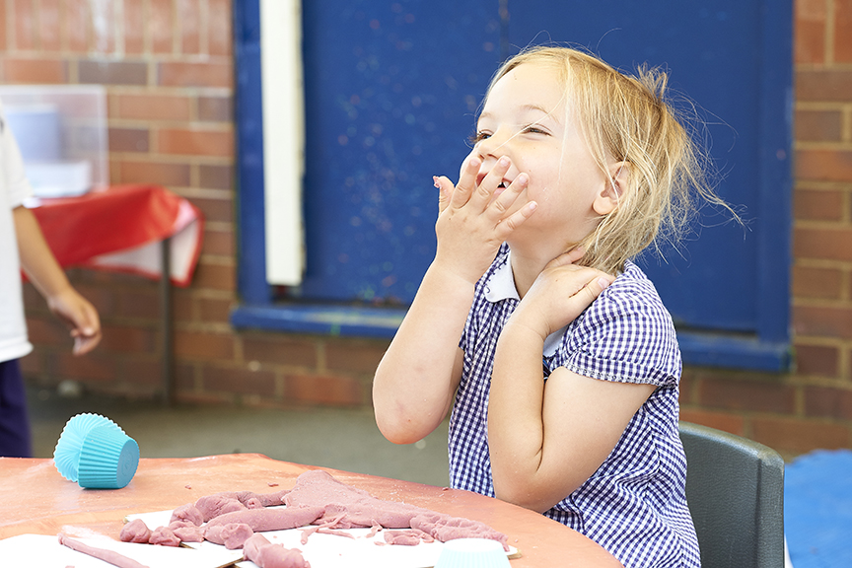
Pre-Unit Quiz: Diagnostic Questions, Misconceptions and Response Signpost
Year 5 Spring 2
Unit 8
Fractions and percentages

Slide 4



Y5 U8 Pre-Unit Q1: To convert between mixed numbers and improper fractions
Convert $\frac{11}{5}$ to a mixed number.
2 remainder 1
$$\frac{22}{10}$$
2 $\frac{1}{5}$
2 $\frac{1}{11}$

Slide 5
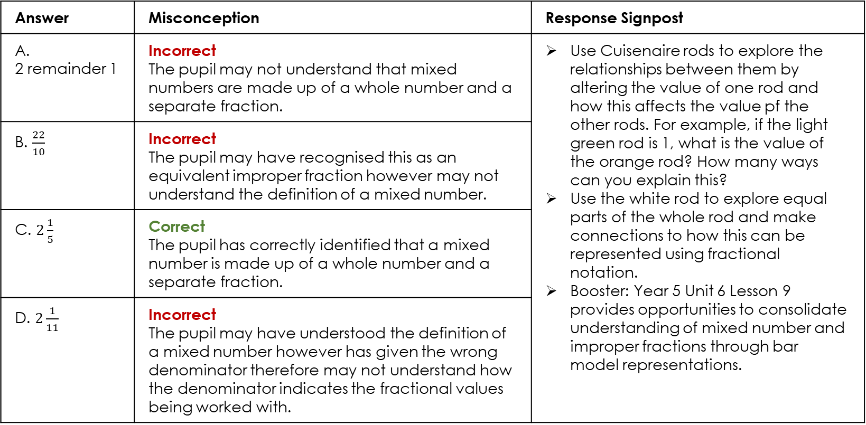
Y5 U8 Pre-Unit Q1: To convert between mixed numbers and improper fractions
Convert $\frac{11}{5}$ to a mixed number.
Answer | Misconception | Response Signpost
A. 2 remainder 1 | Incorrect The pupil may not understand that mixed numbers are made up of a whole number and a separate fraction. | Use Cuisenaire rods to explore the relationships between them by altering the value of one rod and how this affects the value pf the other rods. For example, if the light green rod is 1, what is the value of the orange rod? How many ways can you explain this? Use the white rod to explore equal parts of the whole rod and make connections to how this can be represented using fractional notation. Booster: Year 5 Unit 6 Lesson 9 provides opportunities to consolidate understanding of mixed number and improper fractions through bar model representations.
B. $\frac{22}{10}$ | Incorrect The pupil may have recognised this as an equivalent improper fraction however may not understand the definition of a mixed number.
C. $2\frac{1}{5}$ | Correct The pupil has correctly identified that a mixed number is made up of a whole number and a separate fraction.
D. $2\frac{1}{11}$ | Incorrect The pupil may have understood the definition of a mixed number however has given the wrong denominator therefore may not understand how the denominator indicates the fractional values being worked with.

Slide 6




Y5 U8 Pre-Unit Q2: To convert between mixed numbers and improper fractions
Which improper fraction is equivalent to 3 $\frac{2}{5}$?
$$\frac{6}{5}$$
$$\frac{5}{5}$$
$$\frac{15}{5}$$
$$\frac{17}{5}$$

Slide 7
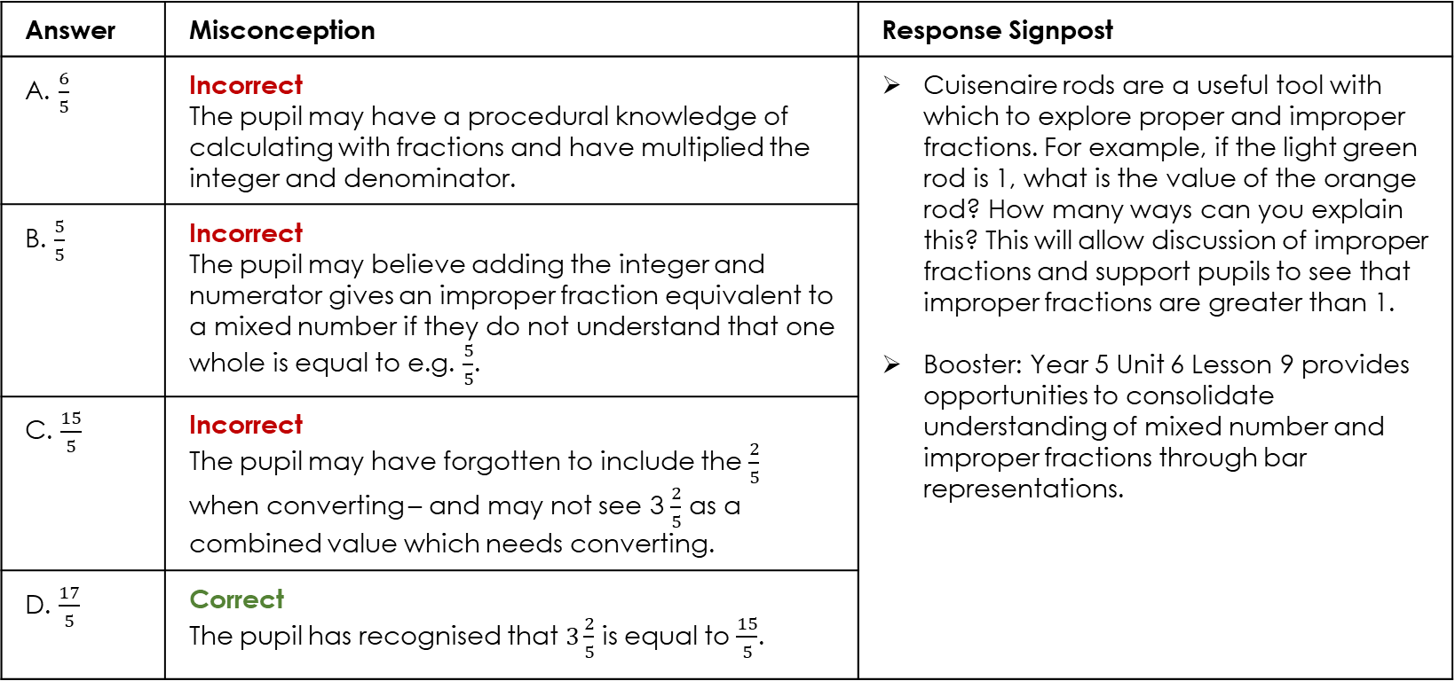
Y5 U8 Pre-Unit Q2: To convert between mixed numbers and improper fractions
Which improper fraction is equivalent to 3 $\frac{2}{5}$?
Answer | Misconception | Response Signpost
A. $\frac{6}{5}$ | Incorrect The pupil may have a procedural knowledge of calculating with fractions and have multiplied the integer and denominator. | Cuisenaire rods are a useful tool with which to explore proper and improper fractions. For example, if the light green rod is 1, what is the value of the orange rod? How many ways can you explain this? This will allow discussion of improper fractions and support pupils to see that improper fractions are greater than 1. Booster: Year 5 Unit 6 Lesson 9 provides opportunities to consolidate understanding of mixed number and improper fractions through bar representations.
B. $\frac{5}{5}$ | Incorrect The pupil may believe adding the integer and numerator gives an improper fraction equivalent to a mixed number if they do not understand that one whole is equal to e.g. $\frac{5}{5}$.
C. $\frac{15}{5}$ | Incorrect The pupil may have forgotten to include the $\frac{2}{5}$ when converting – and may not see 3 $\frac{2}{5}$ as a combined value which needs converting.
D. $\frac{17}{5}$ | Correct The pupil has recognised that $3\frac{2}{5}$ is equal to $\frac{15}{5}$.

Slide 8
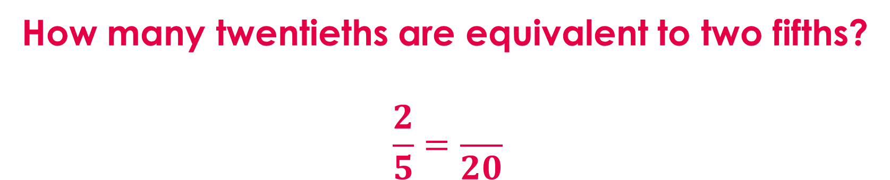
Y5 U8 Pre-Unit Q3: To identify equivalent fractions
How many twentieths are equivalent to two fifths?
$$\frac{2}{5}=\frac{}{20}$$
4
8
50
17

Slide 9
Y5 U8 Pre-Unit Q3: To identify equivalent fractions
How many twentieths are equivalent to two fifths?
Answer | Misconception | Response Signpost
A. 4 | Incorrect The pupil may assume a doubling relationship if they have a procedural understanding of equivalence and simplifying e.g. doubling to find equivalence. | Fold strips of paper and identify equivalent fractions and making chains of equivalent fractions allows pupils to see the multiplicative relationship across (e.g. numerator and denominator are 4x greater) and within (the numerator is always two fifths the value of the denominator). Booster: Year 5 Unit 6 Lesson 3 provides additional opportunities to find equivalent fractions.
B. 8 | Correct The denominator, (whole) has been made 4 times greater therefore the numerator must be four times greater.
C. 50 | Incorrect The pupil may have seen the denominator 20 as 10 times greater than the numerator of 2, so applied this pattern. They may have confused procedures for fractions and do not understand equivalence.
D. 17 | Incorrect The pupil may have incorrectly identified an additive relationship – 20 is 15 greater than 5, so the numerator will be 15 greater. They do not understand the multiplicative relationship of equivalent fractions.

Slide 10



Y5 U8 Pre-Unit Q4: To identify equivalent fractions
Which of these fractions is equivalent to $\frac{3}{18}?$
$$\frac{1.5}{9}$$
$$\frac{1}{16}$$
$$\frac{1}{6}$$
None because 3 is prime

Slide 11
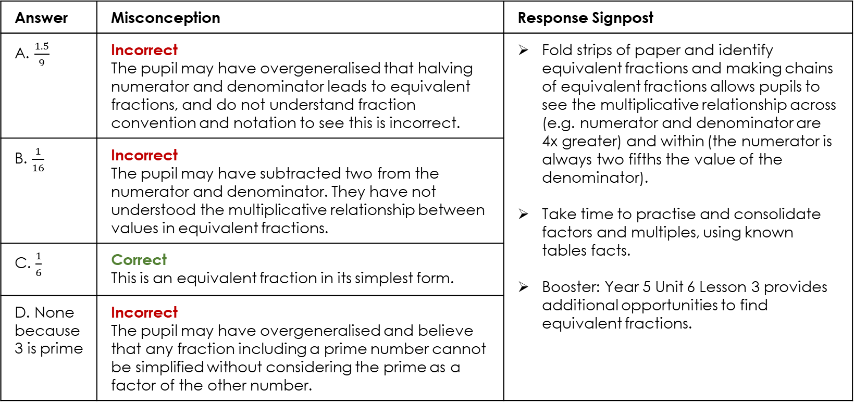
Y5 U8 Pre-Unit Q4: To identify equivalent fractions
Which of these fractions is equivalent to $\frac{3}{18}?$
Answer | Misconception | Response Signpost
A. $\frac{1.5}{9}$ | Incorrect The pupil may have overgeneralised that halving numerator and denominator leads to equivalent fractions, and do not understand fraction convention and notation to see this is incorrect. | Fold strips of paper and identify equivalent fractions and making chains of equivalent fractions allows pupils to see the multiplicative relationship across (e.g. numerator and denominator are 4x greater) and within (the numerator is always two fifths the value of the denominator). Take time to practise and consolidate factors and multiples, using known tables facts. Booster: Year 5 Unit 6 Lesson 3 provides additional opportunities to find equivalent fractions.
B. $\frac{1}{16}$ | Incorrect The pupil may have subtracted two from the numerator and denominator. They have not understood the multiplicative relationship between values in equivalent fractions.
C. $\frac{1}{6}$ | Correct This is an equivalent fraction in its simplest form.
D. None because 3 is prime | Incorrect The pupil may have overgeneralised and believe that any fraction including a prime number cannot be simplified without considering the prime as a factor of the other number.

Slide 12




Y5 U8 Pre-Unit Q5: To add and subtract fractions within 1
What is the sum of $\frac{2}{7}$ and $\frac{4}{7}$?
$$\frac{6}{7}$$
$$\frac{6}{14}$$
$$\frac{8}{49}$$
$$\frac{2}{7}$$

Slide 13
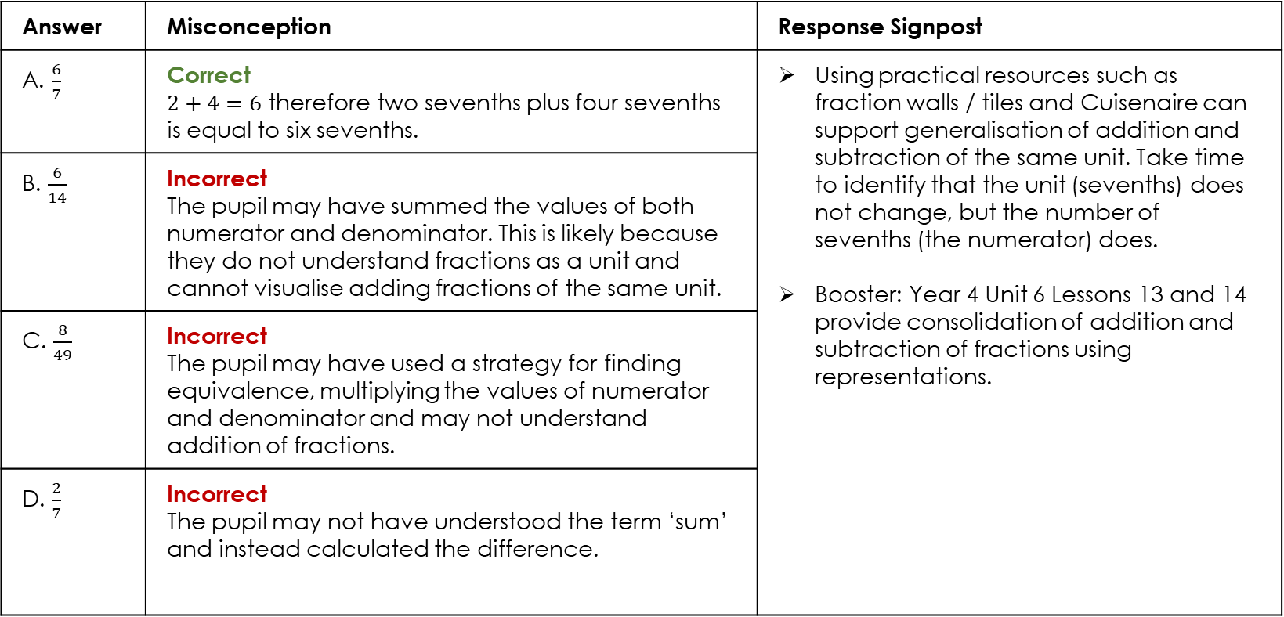
Y5 U8 Pre-Unit Q5: To add and subtract fractions within 1
What is the sum of $\frac{2}{7}$ and $\frac{4}{7}$?
Answer | Misconception | Response Signpost
A. $\frac{6}{7}$ | Correct $2+4=6$ therefore two sevenths plus four sevenths is equal to six sevenths. | Using practical resources such as fraction walls / tiles and Cuisenaire can support generalisation of addition and subtraction of the same unit. Take time to identify that the unit (sevenths) does not change, but the number of sevenths (the numerator) does. Booster: Year 4 Unit 6 Lessons 13 and 14 provide consolidation of addition and subtraction of fractions using representations.
B. $\frac{6}{14}$ | Incorrect The pupil may have summed the values of both numerator and denominator. This is likely because they do not understand fractions as a unit and cannot visualise adding fractions of the same unit.
C. $\frac{8}{49}$ | Incorrect The pupil may have used a strategy for finding equivalence, multiplying the values of numerator and denominator and may not understand addition of fractions.
D. $\frac{2}{7}$ | Incorrect The pupil may not have understood the term ‘sum’ and instead calculated the difference.

Slide 14

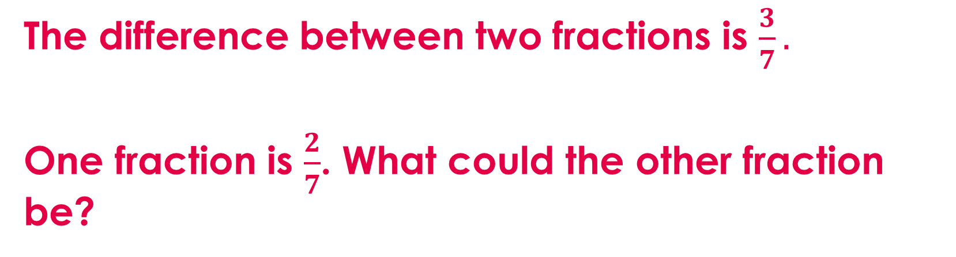



Y5 U8 Pre-Unit Q6: To add and subtract fractions within 1
The difference between two fractions is $\frac{3}{7}.$
One fraction is $\frac{2}{7}$. What could the other fraction be?
$$\frac{1}{0}$$
$$\frac{5}{14}$$
$$\frac{1}{7}$$
$$\frac{5}{7}$$

Slide 15
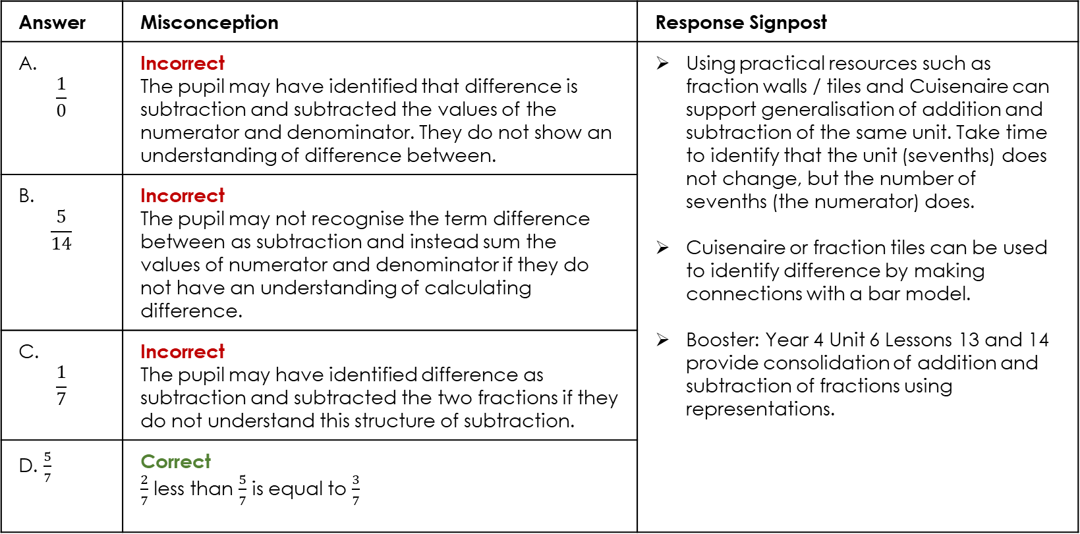
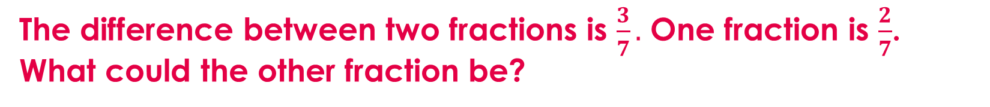
Y5 U8 Pre-Unit Q6: To add and subtract fractions within 1
The difference between two fractions is $\frac{3}{7}.$ One fraction is $\frac{2}{7}$. What could the other fraction be?
Answer | Misconception | Response Signpost
A. $$\frac{1}{0}$$ | Incorrect The pupil may have identified that difference is subtraction and subtracted the values of the numerator and denominator. They do not show an understanding of difference between. | Using practical resources such as fraction walls / tiles and Cuisenaire can support generalisation of addition and subtraction of the same unit. Take time to identify that the unit (sevenths) does not change, but the number of sevenths (the numerator) does. Cuisenaire or fraction tiles can be used to identify difference by making connections with a bar model. Booster: Year 4 Unit 6 Lessons 13 and 14 provide consolidation of addition and subtraction of fractions using representations.
B. $$\frac{5}{14}$$ | Incorrect The pupil may not recognise the term difference between as subtraction and instead sum the values of numerator and denominator if they do not have an understanding of calculating difference.
C. $$\frac{1}{7}$$ | Incorrect The pupil may have identified difference as subtraction and subtracted the two fractions if they do not understand this structure of subtraction.
D. $\frac{5}{7}$ | Correct $\frac{2}{7}$ less than $\frac{5}{7}$ is equal to $\frac{3}{7}$

Slide 16

Y5 U8 Pre-Unit Q7: To calculate unit fractions of amounts
Ria has £250. She spends $\frac{1}{5}$ of her money on shoes. How much does she spend?
£5
£50
£200
£25

Slide 17
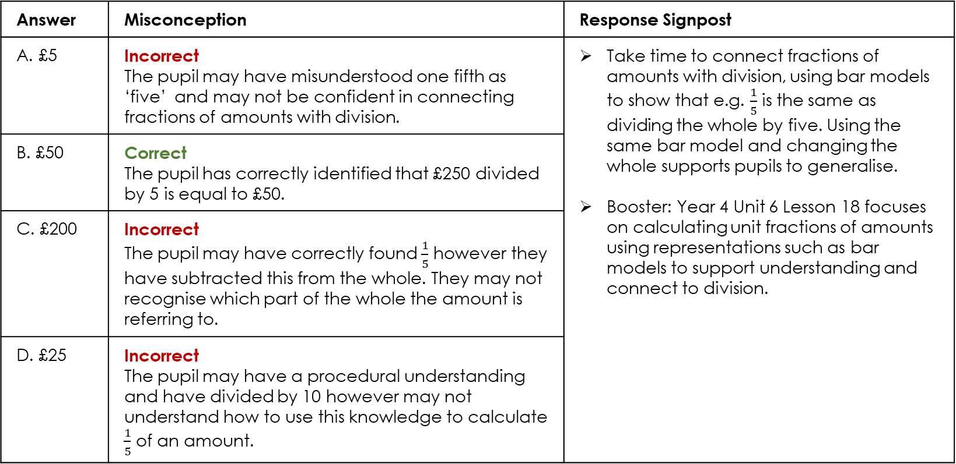

Y5 U8 Pre-Unit Q7: To calculate unit fractions of amounts
Ria has £250. She spends $\frac{1}{5}$ of her money on shoes. How much does she spend?
Answer | Misconception | Response Signpost
A. £5 | Incorrect The pupil may have misunderstood one fifth as ‘five’ and may not be confident in connecting fractions of amounts with division. | Take time to connect fractions of amounts with division, using bar models to show that e.g. $\frac{1}{5}$ is the same as dividing the whole by five. Using the same bar model and changing the whole supports pupils to generalise. Booster: Year 4 Unit 6 Lesson 18 focuses on calculating unit fractions of amounts using representations such as bar models to support understanding and connect to division.
B. £50 | Correct The pupil has correctly identified that £250 divided by 5 is equal to £50.
C. £200 | Incorrect The pupil may have correctly found $\frac{1}{5}$ however they have subtracted this from the whole. They may not recognise which part of the whole the amount is referring to.
D. £25 | Incorrect The pupil may have a procedural understanding and have divided by 10 however may not understand how to use this knowledge to calculate $\frac{1}{5}$ of an amount.

Slide 18
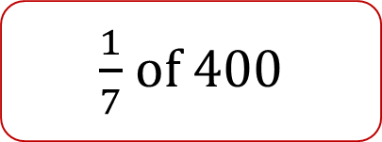

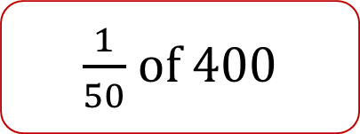
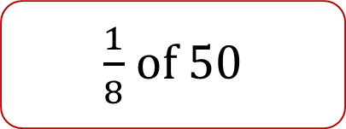
Y5 U8 Pre-Unit Q8: To calculate unit fractions of amounts
What calculation does this bar model show?
400
50
$\frac{1}{8}$ of 400
$\frac{1}{7}$ of 400
$\frac{1}{8}$ of 50
$\frac{1}{50}$ of 400

Slide 19
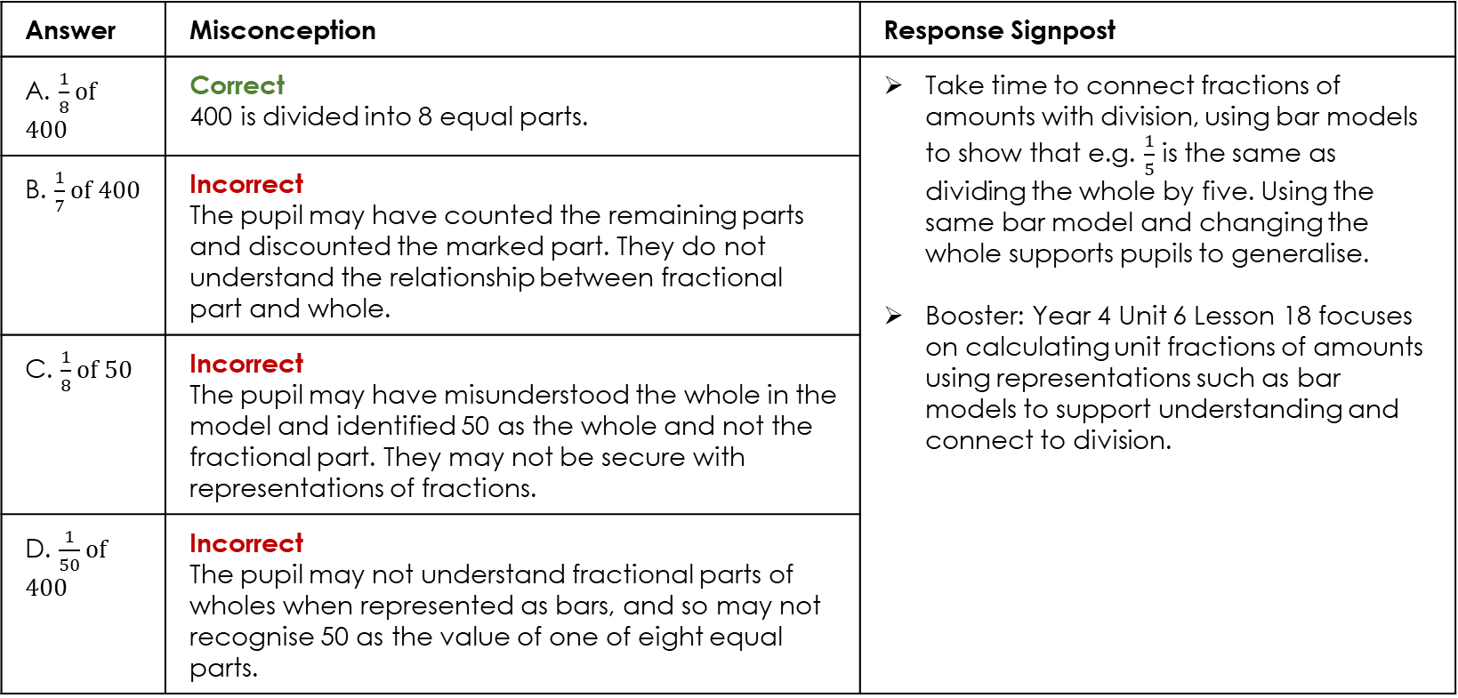
Y5 U8 Pre-Unit Q8: To calculate unit fractions of amounts
What calculation does this bar model show?
Answer | Misconception | Response Signpost
A. $\frac{1}{8}$ of 400 | Correct 400 is divided into 8 equal parts. | Take time to connect fractions of amounts with division, using bar models to show that e.g. $\frac{1}{5}$ is the same as dividing the whole by five. Using the same bar model and changing the whole supports pupils to generalise. Booster: Year 4 Unit 6 Lesson 18 focuses on calculating unit fractions of amounts using representations such as bar models to support understanding and connect to division.
B. $\frac{1}{7}$ of 400 | Incorrect The pupil may have counted the remaining parts and discounted the marked part. They do not understand the relationship between fractional part and whole.
C. $\frac{1}{8}$ of 50 | Incorrect The pupil may have misunderstood the whole in the model and identified 50 as the whole and not the fractional part. They may not be secure with representations of fractions.
D. $\frac{1}{50}$ of 400 | Incorrect The pupil may not understand fractional parts of wholes when represented as bars, and so may not recognise 50 as the value of one of eight equal parts.

Slide 20
Y5 U9 Pre-Unit Q9: To identify hundredths
How many hundredths are equivalent to $\frac{3}{4}?$
34
75
25
300

Slide 21
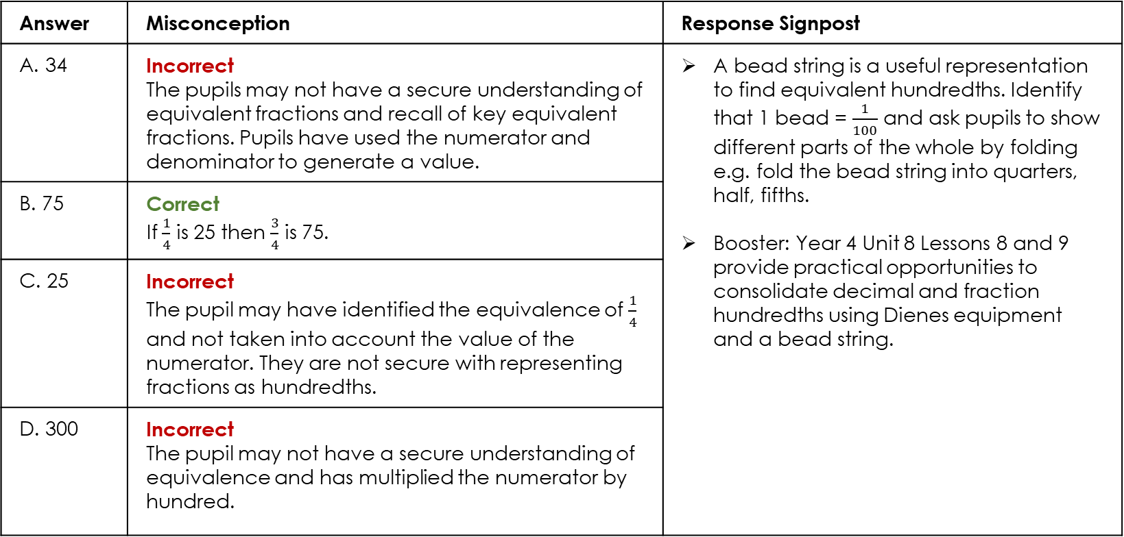
Y5 U9 Pre-Unit Q9: To identify hundredths
How many hundredths are equivalent to $\frac{3}{4}?$
Answer | Misconception | Response Signpost
A. 34 | Incorrect The pupils may not have a secure understanding of equivalent fractions and recall of key equivalent fractions. Pupils have used the numerator and denominator to generate a value. | A bead string is a useful representation to find equivalent hundredths. Identify that 1 bead = $\frac{1}{100}$ and ask pupils to show different parts of the whole by folding e.g. fold the bead string into quarters, half, fifths. Booster: Year 4 Unit 8 Lessons 8 and 9 provide practical opportunities to consolidate decimal and fraction hundredths using Dienes equipment and a bead string.
B. 75 | Correct If $\frac{1}{4}$ is 25 then $\frac{3}{4}$ is 75.
C. 25 | Incorrect The pupil may have identified the equivalence of $\frac{1}{4}$ and not taken into account the value of the numerator. They are not secure with representing fractions as hundredths.
D. 300 | Incorrect The pupil may not have a secure understanding of equivalence and has multiplied the numerator by hundred.

Slide 22
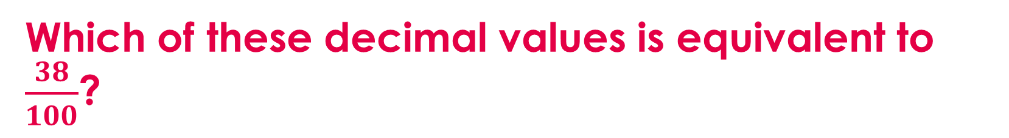
Y5 U9 Pre-Unit Q10: To identify hundredths
Which of these decimal values is equivalent to $\frac{38}{100}$?
0.308
3.8
0.38
0.038

Slide 23
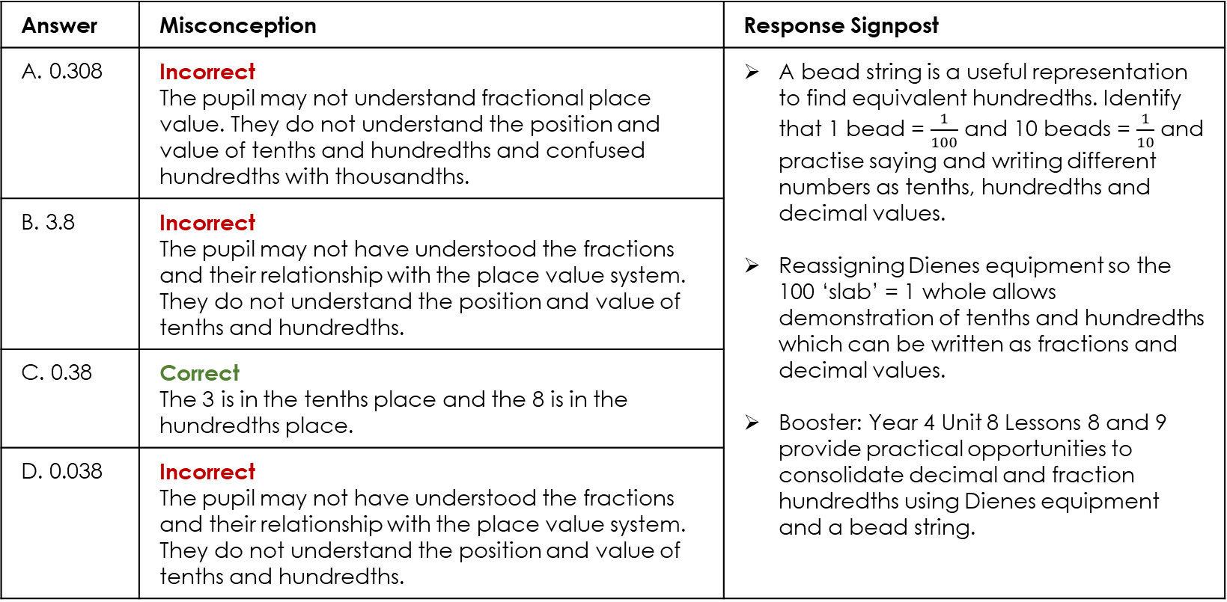
Y5 U9 Pre-Unit Q10: To identify hundredths
Which of these decimal values is equivalent to $\frac{3}{10}+\frac{8}{100}$?
Answer | Misconception | Response Signpost
A. 0.308 | Incorrect The pupil may not understand fractional place value. They do not understand the position and value of tenths and hundredths and confused hundredths with thousandths. | A bead string is a useful representation to find equivalent hundredths. Identify that 1 bead = $\frac{1}{100}$ and 10 beads = $\frac{1}{10}$ and practise saying and writing different numbers as tenths, hundredths and decimal values. Reassigning Dienes equipment so the 100 ‘slab’ = 1 whole allows demonstration of tenths and hundredths which can be written as fractions and decimal values. Booster: Year 4 Unit 8 Lessons 8 and 9 provide practical opportunities to consolidate decimal and fraction hundredths using Dienes equipment and a bead string.
B. 3.8 | Incorrect The pupil may not have understood the fractions and their relationship with the place value system. They do not understand the position and value of tenths and hundredths.
C. 0.38 | Correct The 3 is in the tenths place and the 8 is in the hundredths place.
D. 0.038 | Incorrect The pupil may not have understood the fractions and their relationship with the place value system. They do not understand the position and value of tenths and hundredths.

Slide 24




Y5 U8 Pre-Unit Q11: To compare fractions
Which statement is correct?
$$\frac{1}{2}<\frac{1}{3}$$
$$\frac{2}{5}<\frac{3}{10}$$
$$\frac{1}{4}>\frac{2}{8}$$
$$\frac{1}{3}>\frac{1}{5}$$

Slide 25
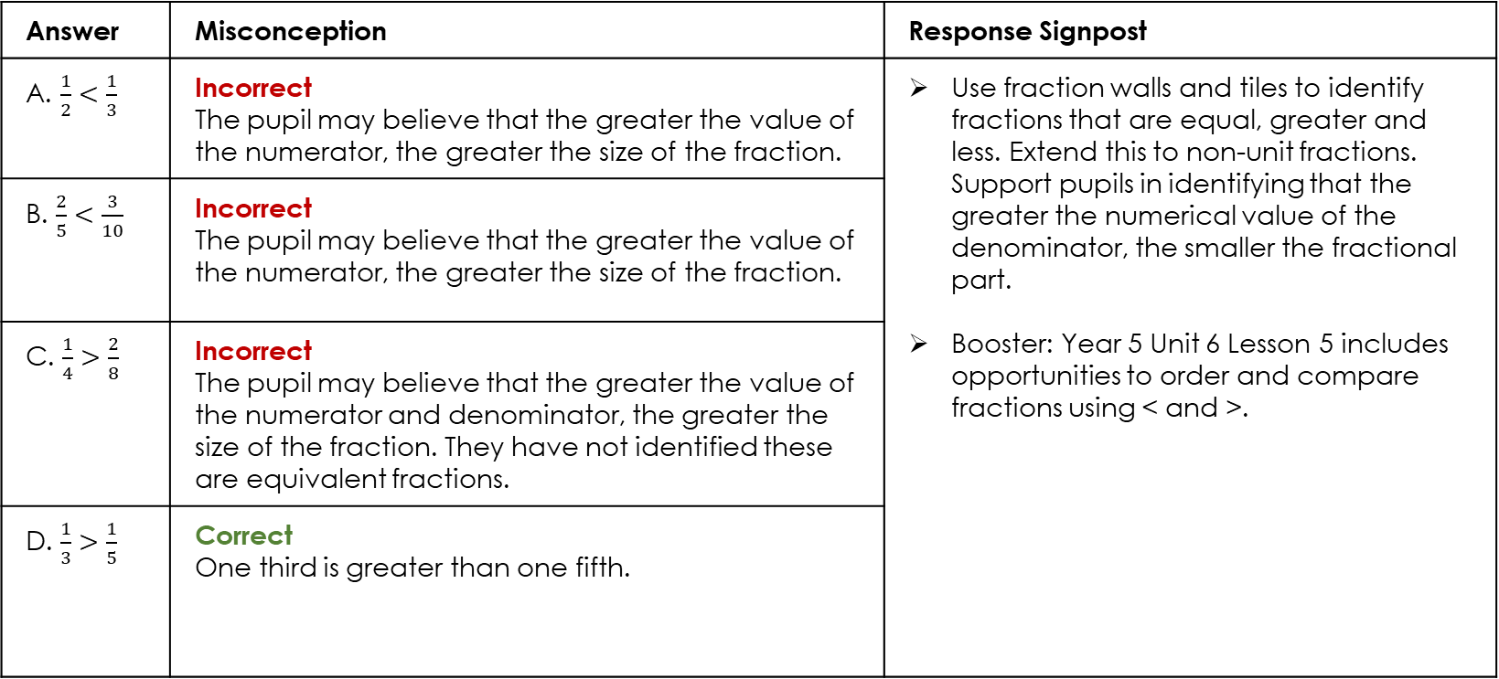
Y5 U8 Pre-Unit Q11: To compare fractions
Which statement is correct?
Answer | Misconception | Response Signpost
A. $\frac{1}{2}<\frac{1}{3}$ | Incorrect The pupil may believe that the greater the value of the numerator, the greater the size of the fraction. | Use fraction walls and tiles to identify fractions that are equal, greater and less. Extend this to non-unit fractions. Support pupils in identifying that the greater the numerical value of the denominator, the smaller the fractional part. Booster: Year 5 Unit 6 Lesson 5 includes opportunities to order and compare fractions using < and >.
B. $\frac{2}{5}<\frac{3}{10}$ | Incorrect The pupil may believe that the greater the value of the numerator, the greater the size of the fraction.
C. $\frac{1}{4}>\frac{2}{8}$ | Incorrect The pupil may believe that the greater the value of the numerator and denominator, the greater the size of the fraction. They have not identified these are equivalent fractions.
D. $\frac{1}{3}>\frac{1}{5}$ | Correct One third is greater than one fifth.

Slide 26
Pre-Unit Quiz: Pupil version
Year 5 Spring 2
Unit 8
Fractions and percentages

Slide 27
Q1. Convert $\frac{11}{5}$ to a mixed number.
2 remainder 1
$$\frac{22}{10}$$
2 $\frac{1}{5}$
2 $\frac{1}{11}$

Slide 28
Q2. Which improper fraction is equivalent to 3 $\frac{2}{5}$?
$$\frac{6}{5}$$
$$\frac{5}{5}$$
$$\frac{15}{5}$$
$$\frac{17}{5}$$

Slide 29
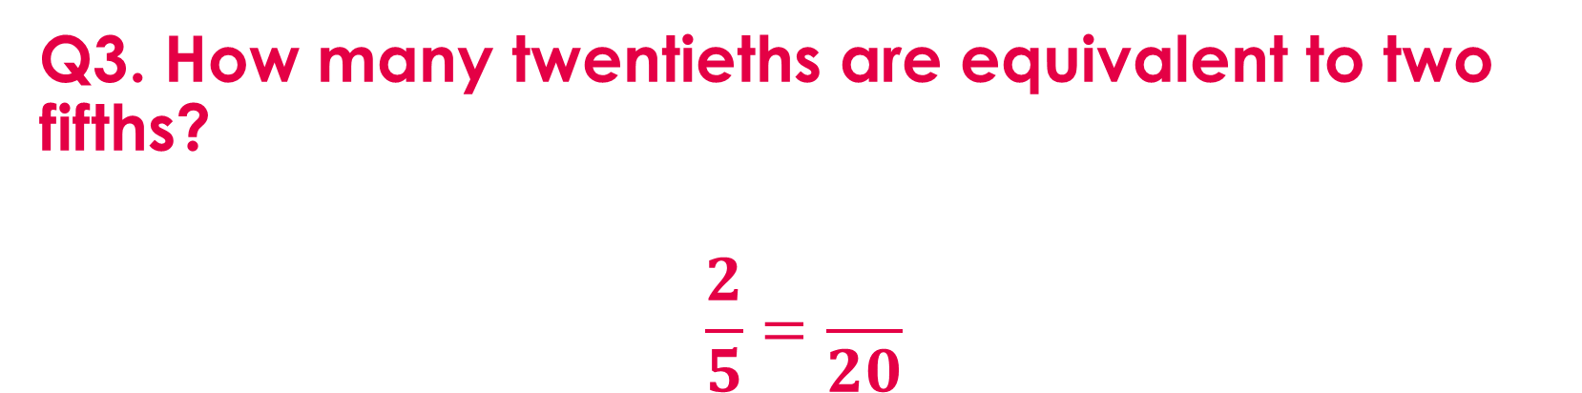
Q3. How many twentieths are equivalent to two fifths?
$$\frac{2}{5}=\frac{}{20}$$
4
8
50
17

Slide 30
Q4. Which of these fractions is equivalent to $\frac{3}{18}?$
$$\frac{1.5}{9}$$
$$\frac{1}{16}$$
$$\frac{1}{6}$$
None because 3 is prime

Slide 31
Q5. What is the sum of $\frac{2}{7}$ and $\frac{4}{7}$?
$$\frac{6}{7}$$
$$\frac{6}{14}$$
$$\frac{8}{49}$$
$$\frac{2}{7}$$

Slide 32
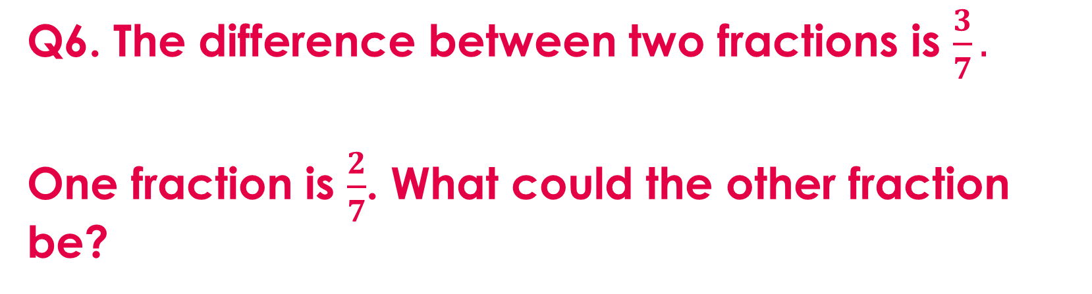
Q6. The difference between two fractions is $\frac{3}{7}.$
One fraction is $\frac{2}{7}$. What could the other fraction be?
$$\frac{1}{0}$$
$$\frac{5}{14}$$
$$\frac{1}{7}$$
$$\frac{5}{7}$$

Slide 33
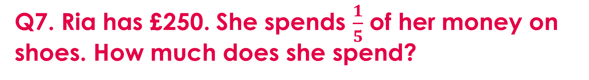
Q7. Ria has £250. She spends $\frac{1}{5}$ of her money on shoes. How much does she spend?
£5
£50
£200
£25

Slide 34
Q8. What calculation does this bar model show?
400
50
$\frac{1}{8}$ of 400
$\frac{1}{7}$ of 400
$\frac{1}{8}$ of 50
$\frac{1}{50}$ of 400

Slide 35
Q9. How many hundredths are equivalent to $\frac{3}{4}?$
34
75
25
300

Slide 36
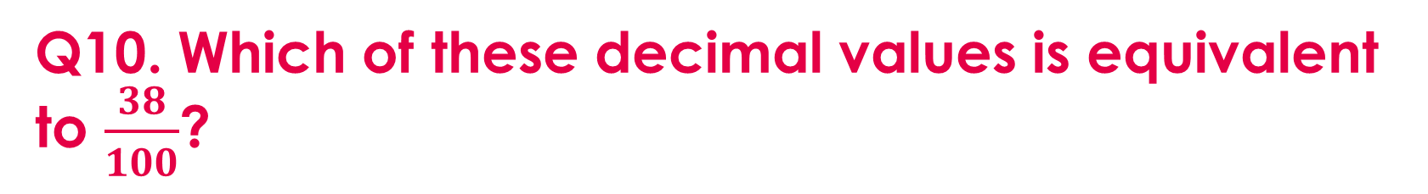
Q10. Which of these decimal values is equivalent to $\frac{38}{100}$?
0.308
3.8
0.38
0.038

Slide 37
Q11. Which statement is correct?
$$\frac{1}{2}<\frac{1}{3}$$
$$\frac{2}{5}<\frac{3}{10}$$
$$\frac{1}{4}>\frac{2}{8}$$
$$\frac{1}{3}>\frac{1}{5}$$

