Slide 1
Spelling at St John’s

Slide 2
How do we assess writing?
Spelling
handwriting
Writing
composition
Greater depth
Expected
Working Towards
Vocabulary, grammar and punctuation

Slide 3
https://www.st-johns-pri.bham.sch.uk/spelling-3/

Slide 4
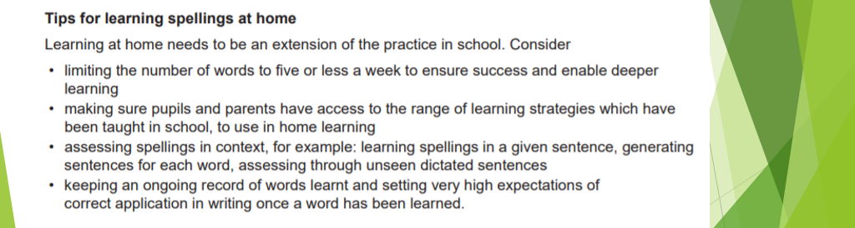

Slide 5
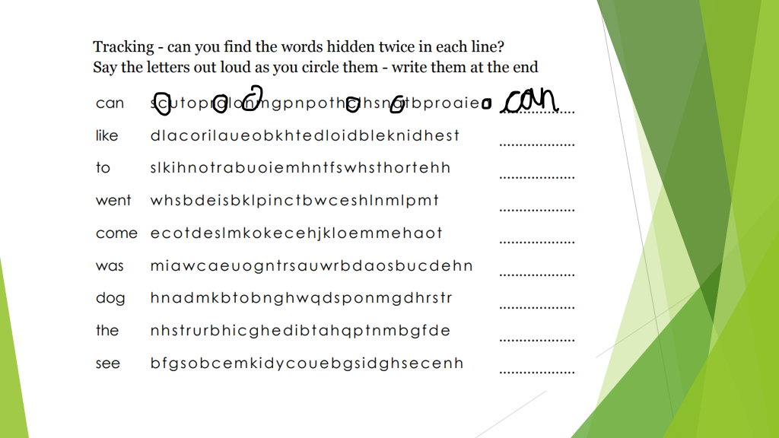

Slide 6
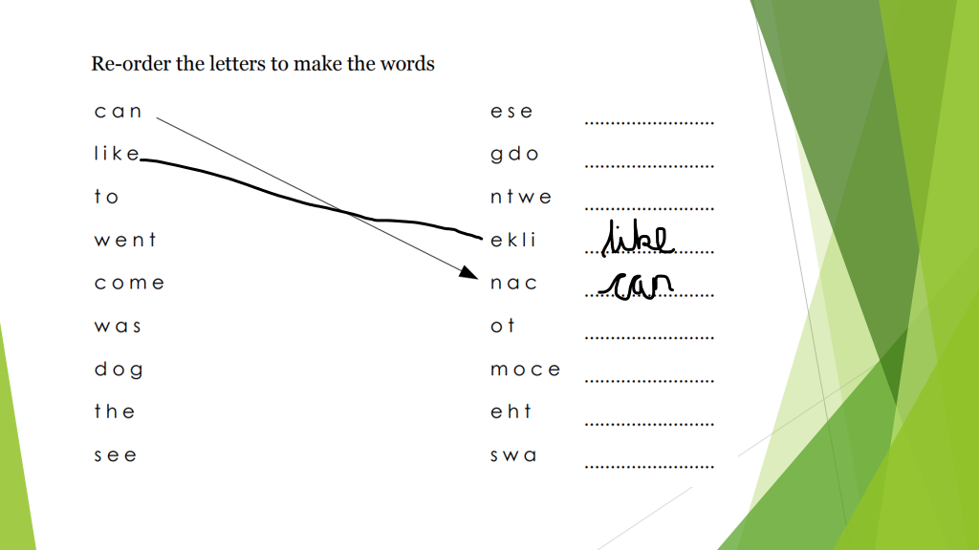

Slide 7


