Slide 1
To Play, click on Slide Show (above) and play from the beginning.

Slide 2


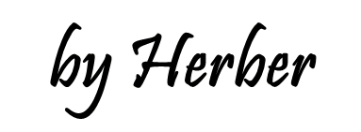

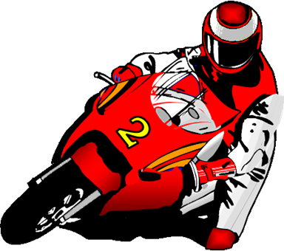
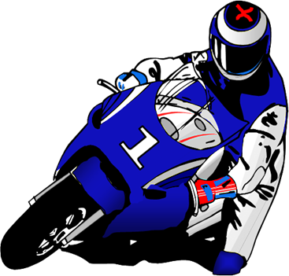

MUCH - MANY

Slide 3
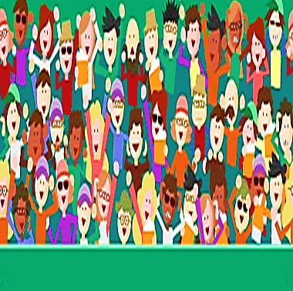
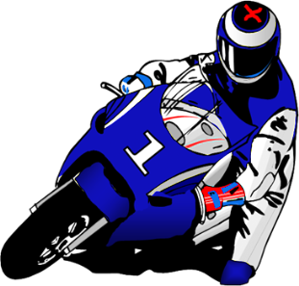
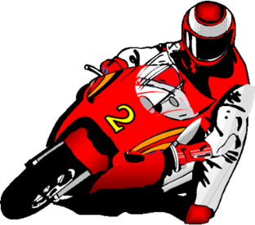
1/10
much
We don't drink _______ coffee.
much
many
NEXT

Slide 4

2/10
much
You don't have ________ time to do this test.
much
many
NEXT

Slide 5
3/10
many
Greg doesn't have _________ friends.
much
many
NEXT

Slide 6
4/10
many
He doesn't read ________ newspapers.
much
many
NEXT

Slide 7
5/10
much
They don't have ________ money.
much
many
NEXT

Slide 8
6/10
much
Is there _______ milk in the fridge?
much
many
NEXT

Slide 9
7/10
Are there ________ people in the room?
many
much
many
NEXT

Slide 10
8/10
How _______ work do you have to do?
much
much
many
NEXT

Slide 11
9/10
many
Did you see _______ people at the beach?
much
many
NEXT

Slide 12
10/10
How ______ times have you been to England?
many
much
many
EXIT

