Slide 1
Phrasal Verbs
A phrasal verb is made up of 2 or more particles: switch off get up
Phrasal verb = verb + particle (preposition or adverb)

Slide 2


Slide 3
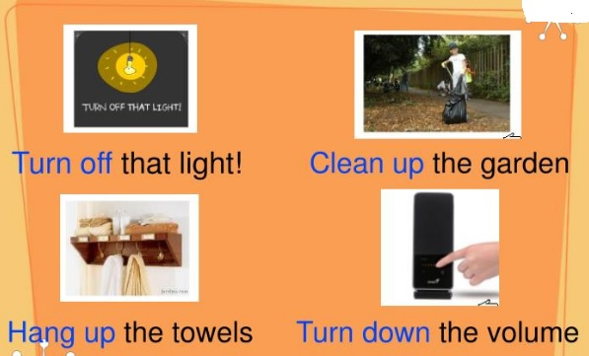

Slide 4
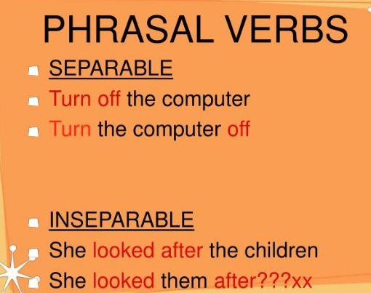

Slide 5
Actions
Click on the action to see the sentence.

Slide 6

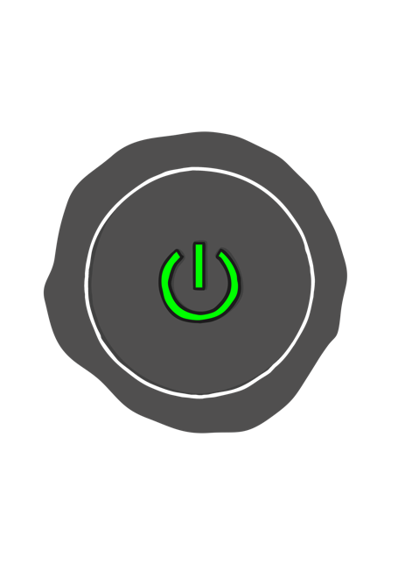

Turn on your computer.

Slide 7
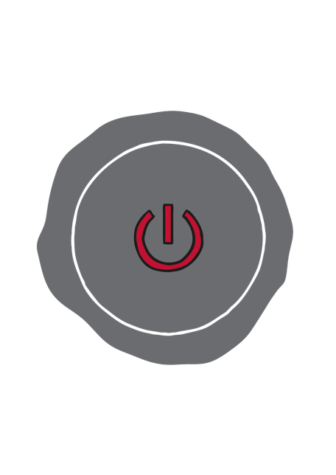
Turn off your computer.

Slide 8
Log into your account.
SIGN IN
SIGN IN

Slide 9
Log out of your account.
LOG OUT
LOG OUT

Slide 10
Click on the button.

Slide 11
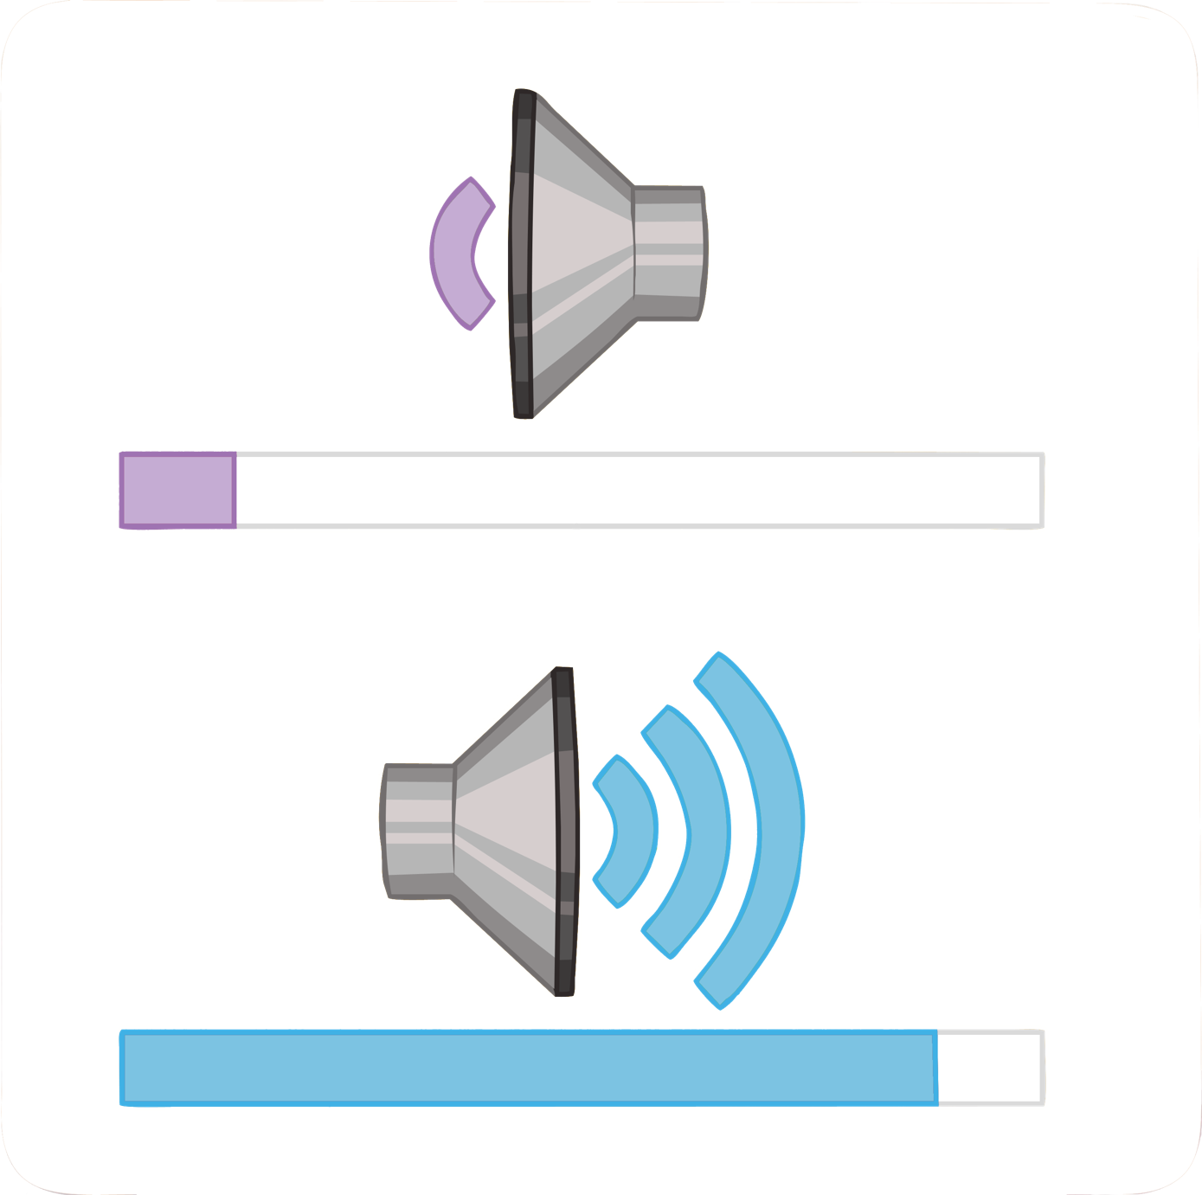
Turn up the volume.

Slide 12
Turn down the volume.

Slide 13
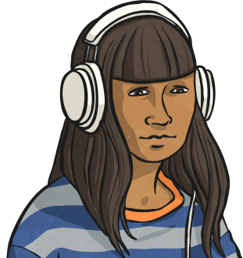
Put your headphones on.

Slide 14

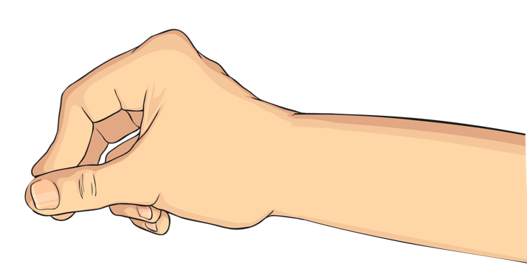
Take your headphones off.

Slide 15


Speak into the microphone.

Slide 16
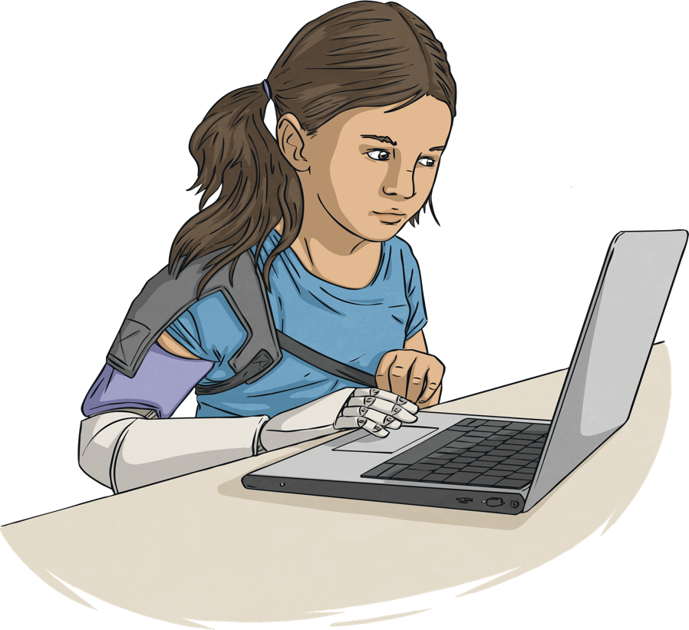
Look into the camera.

Slide 17

Plug in your laptop.

Slide 18

Unplug your laptop.

Slide 19

Charge up your phone.

Slide 20
The battery is running out.

Slide 21

Scroll down the page.

Slide 22
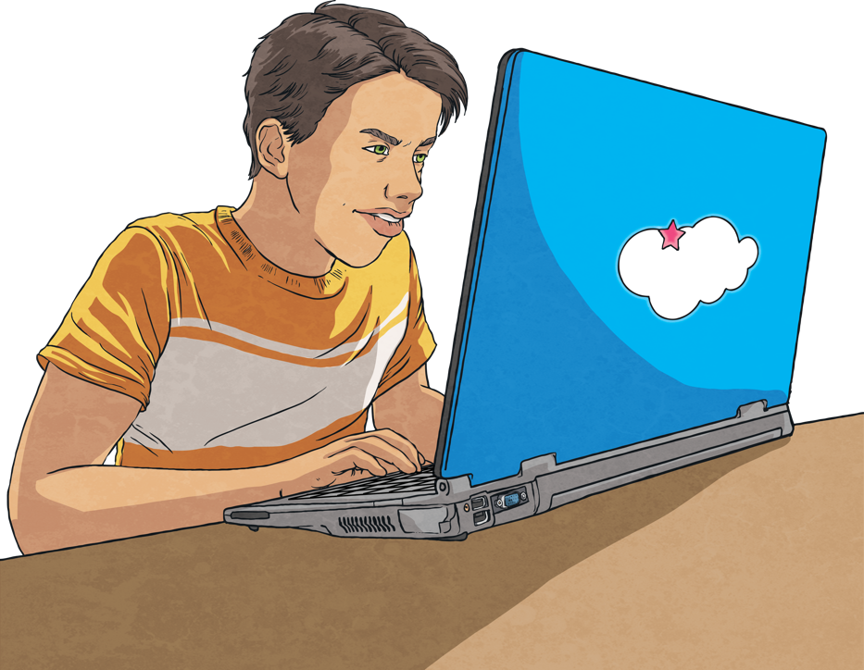
?
Look up the answer on the Internet.
?
?
?

Slide 23
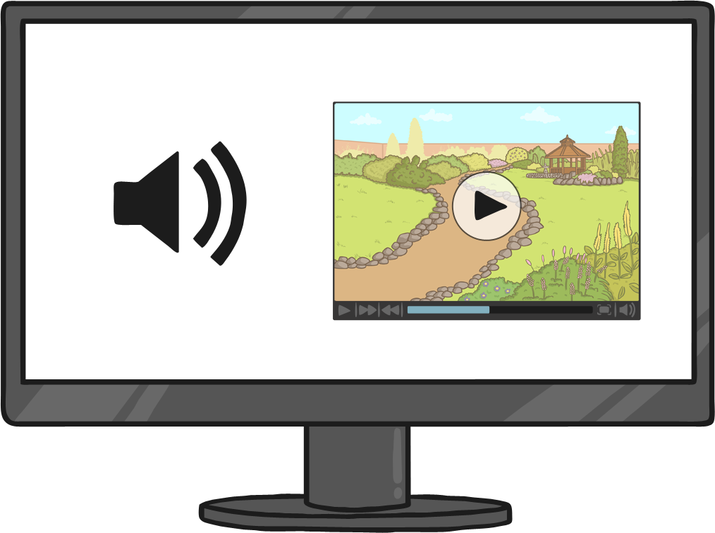
Find out what happened by watching the video.

Slide 24
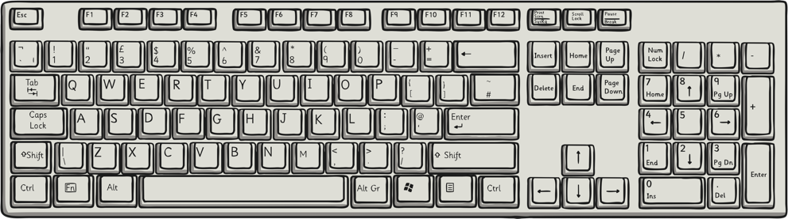
Type in the chat box.

Slide 25
Can you do the action?
Turn on your computer.
Turn off your computer.
Log into your account.
Put your headphones on.
Log out of your account.
Click on the button.
Turn the volume down.
Turn the volume up.
Speak into the microphone.
Take your headphones off.

Slide 26
Can you do the action?
Look into the camera.
Charge up your phone.
Plug in your laptop.
Unplug your laptop.
The battery is running out.
Look up the answer on the Internet.
Scroll down the page.
Find out what happened.
Type in the chat box.

Slide 27
Complete Vocabulary List
computer
laptop
phone
tablet
e-reader
speakers
screen
mouse
keyboard
headphones
earphones
mic or microphone
camera
charger
plug
socket
Turn on your computer.
Turn off your computer.
Log into your account.
Log out of your account.
Click on the button.
Turn the volume up.
Turn the volume down.
Put your headphones on.
Take your headphones off.
Speak into the microphone.
Look into the camera.
Plug in your laptop.
Unplug your laptop.
Charge up your phone.
The battery is running out.
Scroll down the page.
Look up the answer on the Internet.
Find out what happened.
Type in the chat box.

