Slide 1

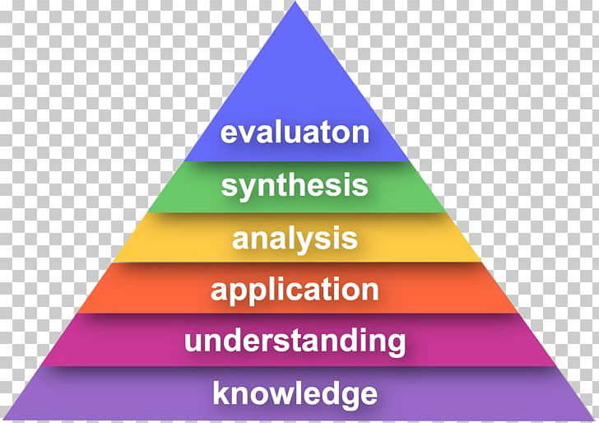
Challenging High Attainment Pupils in ART Y1 – Y6
Bloom’s Taxonomy
Greater Depth is NOT about just knowing more information!
Greater Depth in Art is about style, choice, purpose, skills and technique
General
Cooperative learning Learners can lead, explain and teach concepts to others (recall, explain, question).
Level of independence Learners should tackle more difficult tasks with greater levels of independence.
Higher Order Skills Learners access deeper level of interpreting, questioning and analysing through questioning and tasks.
Applying learning in history within the subject e.g. connecting learning from previous year groups
Applying learning in history to other subjects and disciplines e.g. maths
Confidence to investigate puzzles Evaluate others’ work
Command GD learners can take disparate bits of information from sources and bring them together to create a piece of work.
Challenging higher attainer children in Art and Design involves allowing pupils the independence to apply their learning at a deeper level. They are the pupils who show natural talent and are able to take an idea or a new skill and adapt it or develop it further independently.
Higher attaining pupils will:
research an art movement or artist in greater depth and adapt ideas and process into their own art
display a higher level of technical skill with a broad range of tools and media and think of innovative ways to use this knowledge to enhance creativity
make purposeful stylistic choices and develop a style of their own
evaluate work with more analytical understanding and critique and will work independently to assess and improve their work
will have a greater breadth of knowledge about artists and key art movements and can explain, make judgements and offer personal opinions about works of art
How would a child’s Mastery of Art and Design present itself?
Generating Ideas: Showing greater complexity, research, observation, originality, perception, aspiration, creativity
Making: Showing greater technique, skill, control, complexity, mastery, quality, judgement, creativity
Evaluating: Showing greater judgement, autonomy, independence, perception, subtlety
Knowledge: Showing greater breadth, contextual understanding, explanation, judgement

