Slide 1


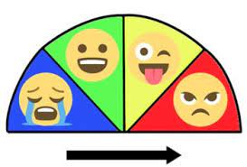
Engaging SEN Learning in ART Y1 – Y6
Areas of Need
Communication and Interaction
Carefully considered of pairings of all children. SEN children to work alongside other children to promote engagement in learning.
Use of Kagan techniques to promote purposeful cooperative learning.
Thought given to communication styles for SEN children e.g. actions, symbols.
Extra time and support given for processing and responding.
Widgets to demonstrate key concepts, ideas, words and resources.
Use of widgets/social stories with visuals to enable discussion about technique, process, artists and art language.
Cognition and Learning
• High quality visuals in the classroom and within a lesson.
• Pre-teaching vocabulary
• Task slicing to help with engaging in content and structure of a lesson
Pre-teaching of explicit skills in small groups
• Use of memory aids e.g. talking pegs, mind maps, lists, cue cards.
• Use of visuals in Knowledge Organisers
Physical/Sensory
• Use of differentiated resources eg. larger paint pallets, paintbrush grips
Pre-teaching of explicit skills in small groups
• Differentiated tasks/modified resources and use of multisensory approaches: visual, tactile, auditory
and kinaesthetic.
• Thought given to lighting, environment and seating for SEN children, according to individual needs.
• Thought given to text size and style (for children with visual needs/dyslexia).
Social, Emotional and Mental Health
Self-Monitoring and Regulation.
Use of class
boards Zones of Regulation

