Slide 1

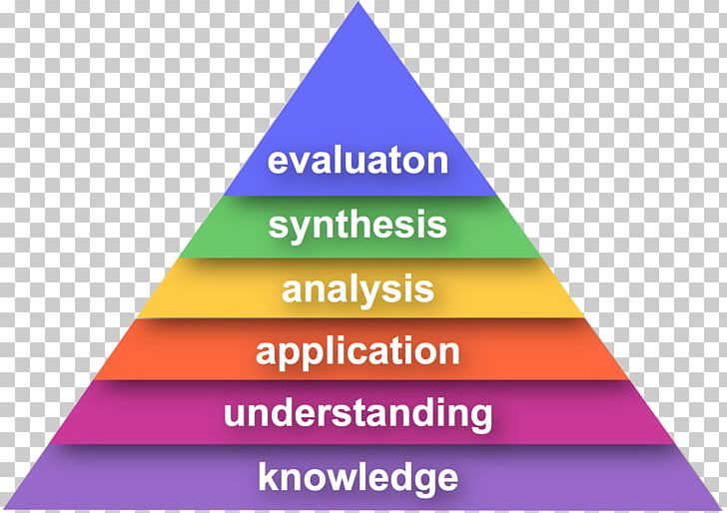
Challenging High Attaining Pupils in DT Lower School Y1 – Y3
Bloom’s Taxonomy
Greater Depth is NOT about just knowing more information!
General
Cooperative learning Learners can lead, explain and teach concepts to others (recall, explain, question).
Level of independence Learners should tackle more difficult tasks with greater levels of independence.
Higher Order Skills Learners access deeper level of interpreting, questioning and analysing through questioning and tasks.
Applying learning in history within the subject e.g. connecting learning from previous year groups
Applying learning in history to other subjects and disciplines e.g. maths /measuring and art/design
Confidence to investigate puzzles GD learners thrive on puzzles and big questions
Evaluate others’ work
Command GD learners can take disparate bits of information from sources and bring them together to create a piece of work.
Investigative and Evaluative Activities (IEAs)
• Children further investigate, analyse and evaluate familiar objects. Think and analyse Who might it be for? What materials have been used?
Design, Make and Evaluate Assignment (DMEA) ​
Develop a design brief with the children within a context which is authentic and meaningful.​
Discuss with children the purpose of the products they will be designing and making and who the products will be for.​
Ask the children to generate a range of ideas, encouraging creative responses. ​
Agree on design criteria that can be used to guide the development and evaluation of the children’s products.
Use annotated sketches and prototypes, ask the children to develop, model and communicate their ideas.
Consider the main stages in making before assembling high quality products, drawing on the knowledge, understanding and skills learnt through IEAs and FTs.
Evaluate the final products against the intended purpose and with the intended user, where safe and practical, drawing on the design criteria previously agreed.

Slide 2
Challenging High Attaining Pupils in DT Upper School Y4 – Y6
Bloom’s Taxonomy
Greater Depth is NOT about just knowing more information!
General
Cooperative learning Learners can lead, explain and teach concepts to others (recall, explain, question).
Level of independence Learners should tackle more difficult tasks with greater levels of independence.
Higher Order Skills Learners access deeper level of interpreting, questioning and analysing through questioning and tasks.
Applying learning in history within the subject e.g. connecting learning from previous year groups
Applying learning in history to other subjects and disciplines e.g. maths
Confidence to investigate puzzles GD learners thrive on puzzles and big questions
Evaluate others’ work
Command GD learners can take disparate bits of information from sources and bring them together to create a piece of work.
Investigative and Evaluative Activities (IEAs)
• Children further investigate, analyse and evaluate familiar objects. Think and analyse Who might it be for? What materials have been used?
Design, Make and Evaluate Assignment (DMEA) ​
Develop a design brief with the children within a context which is authentic and meaningful.​
Discuss with children the purpose of the products they will be designing and making and who the products will be for.​
Ask the children to generate a range of ideas, encouraging creative responses. ​
Agree on design criteria that can be used to guide the development and evaluation of the children’s products.
Use annotated sketches and prototypes, ask the children to develop, model and communicate their ideas.
Consider the main stages in making before assembling high quality products, drawing on the knowledge, understanding and skills learnt through IEAs and FTs.
Evaluate the final products against the intended purpose and with the intended user, where safe and practical, drawing on the design criteria previously agreed.

