Slide 1


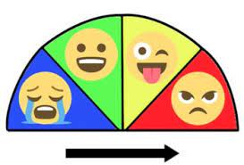
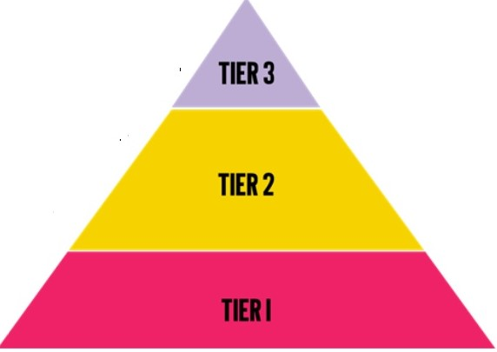
Engaging SEN Learning in DT Lower School Y1 – Y3
Areas of Need
Cognition and Learning
• High quality visuals in the classroom and within a lesson.
• Pre-teaching vocabulary
• Task slicing to help with engaging in content and structure of a lesson
• Use of memory aids e.g. talking pegs, mind maps, lists, cue cards.
Communication and Interaction
• Carefully considered of pairings of all children. SEN children to work alongside other
children to promote engagement in learning.
• Use of Kagan techniques to promote purposeful cooperative learning.
• Thought given to communication styles for SEN children e.g. actions, symbols.
• Extra time and support given for processing and responding.
Physical/Sensory
• Use of ICT– computers/IPADS, bee bots, talking pegs to record children’s learning or teacher given information.
• Differentiated tasks/modified resources and use of multisensory approaches: visual, tactile, auditory and
kinaesthetic.
• Thought given to lighting, environment and seating for SEN children, according to individual needs.
• Thought given to text size and style (for children with visual needs/dyslexia).
SociaL, Emotional and Mental Health
Self-Monitoring and Regulation – use of class
boards Zones of Regulation
DT Areas
DT Terms/Vocabulary
• Tier 2 and Tier 3 Vocabulary Displayed (with images and sound buttons to help challenges with reading).
• Actions for terms . Makaton
Class glossary with Tier 3 Words
Focused Tasks (FTs)
Demonstrate measuring, marking out, cutting, shaping, joining and finishing techniques with a range of tools.
Specially adapted tools e.g. needles with bigger eyes.
Design, Make and Evaluate Assignment (DMEA)
Discuss with the children what they will be designing, making and evaluating 1:1 or in a small group.
Encourage the children to develop their ideas through talking, drawing and making mock-ups of their ideas with construction kits and other materials.
.Use ICT to help design
Investigative and Evaluative Activities
• Appropriate use of visuals, objects, written text, online resources and video to ​
inform children and encourage curiosity (multisensory).​
• Provide opportunities to handle
Go on a walk and/or look at photographs of the local area to explore structures such as playground equipment, street furniture, walls, towers and bridges- Year 2 Let's go engineering
Fun experiences!

Slide 2
Engaging SEN Learning in DT Upper School Y4 – Y6
Areas of Need
Cognition and Learning
• High quality visuals in the classroom and within a lesson.
• Pre-teaching vocabulary
• Task slicing to help with engaging in content and structure of a lesson
• Use of memory aids e.g. talking pegs, mind maps, lists, cue cards.
• Use of visuals in Knowledge Organisers
Communication and Interaction
• Carefully considered of pairings of all children. SEN children to work alongside other
children to promote engagement in learning.
• Use of Kagan techniques to promote purposeful cooperative learning.
• Thought given to communication styles for SEN children e.g. actions, symbols.
• Extra time and support given for processing and responding.
Physical/Sensory
• Use of ICT– computers/IPADS, bee bots, talking pegs to record children’s learning or teacher given information.
• Differentiated tasks/modified resources and use of multisensory approaches: visual, tactile, auditory and
kinaesthetic.
• Thought given to lighting, environment and seating for SEN children, according to individual needs.
• Thought given to text size and style (for children with visual needs/dyslexia).
SociaL, Emotional and Mental Health
Self-Monitoring and Regulation –use of class
boards Zones of Regulation
DT Areas
DT Terms/Vocabulary
• Tier 2 and Tier 3 Vocabulary Displayed (with images and sound buttons to help
challenges with reading).
• Actions for terms Macakton
• Class glossary with Tier 3 Words
• Quizzes to recall vocabulary and learning.
Focused Tasks (FTs)
Demonstrate measuring, marking out, cutting, shaping, joining and finishing techniques with a range of tools.
Specially adapted tools e.g. needles with bigger eyes.
Investigative and Evaluative Activities​
• Appropriate use of visuals, objects, written text, online resources and video to ​​inform children and encourage curiosity (multisensory).​​
• Provide opportunities to handle.
Go on a walk and/or look at photographs of the local area to explore structures such as playground equipment, street furniture, walls, towers and bridges ​
Design, Make and Evaluate Assignment (DMEA)
Discuss with the children what they will be designing, making and evaluating
Encourage the children to develop their ideas through talking, drawing and making mock-ups of their ideas with construction kits and other materials.
.Use ICT to help design

