Slide 1
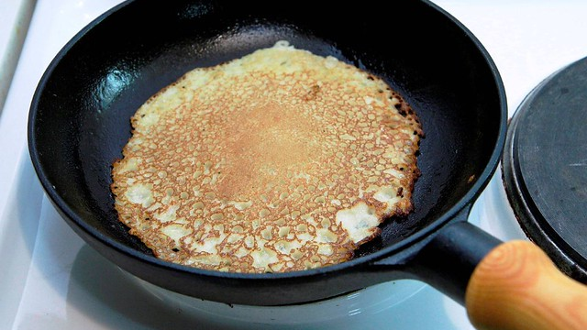
Pancakes
This Photo by Unknown author is licensed under CC BY-SA.

Slide 2
It's Shrove Tuesday, Pancake Day has come.
Time for some cooking, time for having fun.
We'll make some pancakes, lots for everyone.
It's Shrove Tuesday, Pancake Day has come.

Slide 3
Making pancakes needs a careful plan,
Eggs, milk and flour, butter and a pan.
"Better roll your sleeves up, better wash your hands."
Making pancakes needs a careful plan.

Slide 4
For the mixture, this is what you do:
Blend the ingredients with a wooden spoon.
Stir it round in circles till it's nice and smooth.
For the mixture, this is what you do.

Slide 5
Heat some butter in a frying pan.
Pour in the batter, cook it golden brown.
Give the pan a jiggle, shake it all around.
Now toss the pancake.... catch it if you can!
Now toss the pancake.... catch it if you can!

