Slide 1

Getting Started
Please view the Slideshow to begin working through your home learning pack.
Click slide show from the top menu bar and then select from beginning
The slide show will flow following each click of the mouse.

Slide 2

Spanish
Unit 3 – ¡Vamos a celebrarlo!
Home learning pack

Slide 3
During this pack your child will learn how to…
Make simple statements about activities.
Express praise
Months of the year
Write an invitation
Seasons of the year
Simple adverbs
Phonic focus: d making the sound th, consolidation of j, ll, ñ, v and z

Slide 4
Instructions
Complete all tasks.
Email your work to your class teacher to get the correct answers.
Keep a copy of your work so Mr Mattaliano can check it once we are back in school.

Slide 5
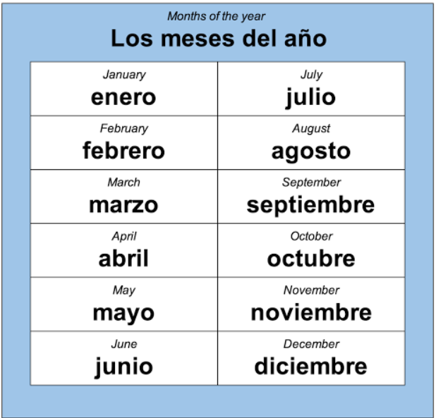
Los meses del año
(The months of the year)
Unlike English, Spanish does not use capital letters for months of the year

Slide 6
Now please complete worksheet 1 - 2

Slide 7
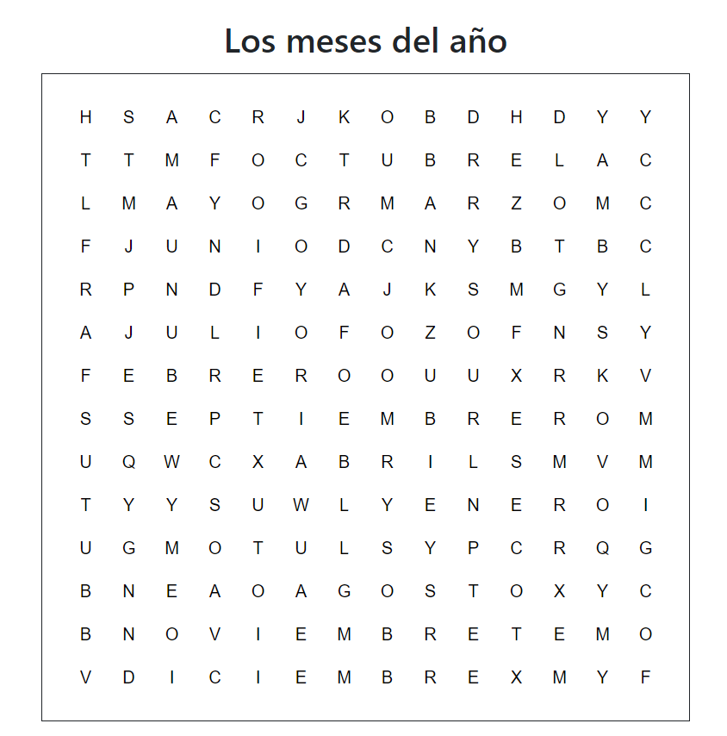
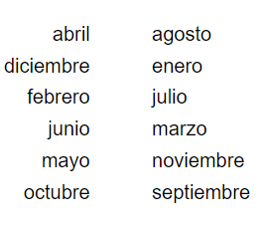
Worksheet 1: Complete the Word Search

Slide 8
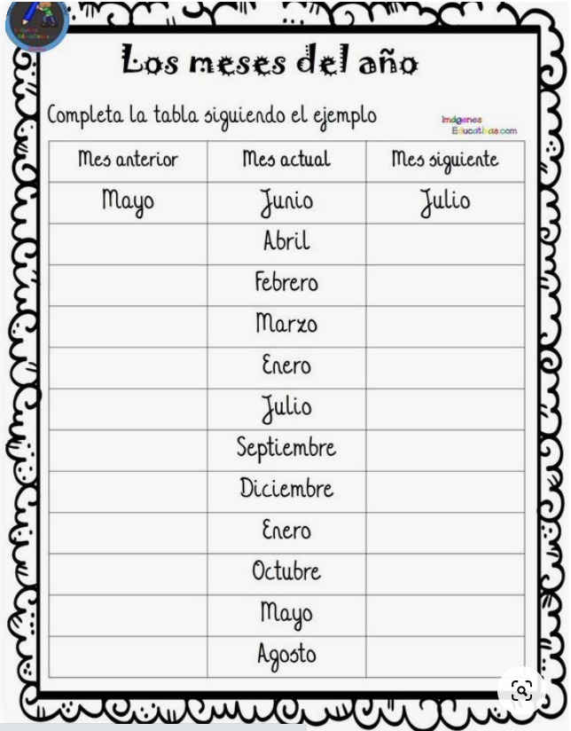
Worksheet 2:
Look at the months on the middle column, and complete the table with the previous month on the left hand side and the following month on the right hand side.
The first one has been done for you!

Slide 9
Please email your work to your class teacher for the correct answers.

