Slide 1

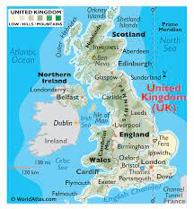
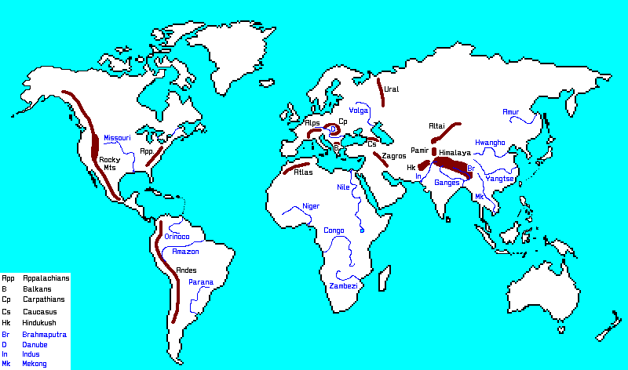
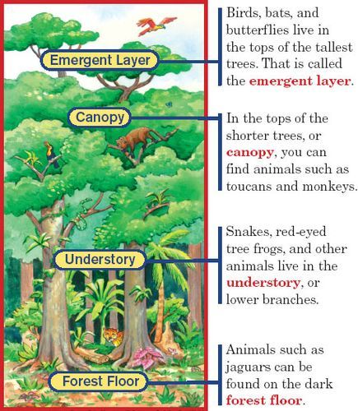
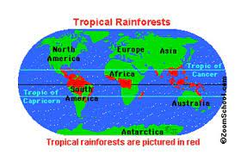
Year 5: Earth Explorers
1. Terms | Definitions
mountains | a landform that rises high above the surrounding terrain in a limited area. They are made from rocks and earth. Generally, mountains are higher than 600 metres
U-shaped Valleys | When a big glacier (see below) melts, it leaves a valley of a deep U-shape
Glaciers | a large body of ice moving slowly down a slope or over a wide area of land.
Tropical Rainforest | forests with tall trees, warm climates, and lots of rain.
biome | A biome is a large region of Earth (such as a tropical rainforest) that has a certain climate and certain types of living things.
climate | average measurements of temperature, wind, humidity, snow, and rain in a place over the course of years.
Equator | an imaginary circle around Earth. It divides Earth into two equal halves called hemispheres.
Tropic of Cancer | an imaginary latitude line located above the equator that runs across the globe at about 23 degrees north
Tropic of Capricorn | an imaginary line of latitude going around the Earth at approximately 23.5° south of the equator
deforestation | the cutting down of forests or groups of trees which is then turned into non-forest use.
Layers of the rainforest | Forest floor, understory, canopy and emergent layer (see diagram for more details)
UK Mountains and Mountain Ranges
Ben Nevis is the UK's highest peak. It is in the Grampian Mountain range in Scotland. It is 1345m high – so high that there is snow on the top all year round!
Scafell Pike in the Lake District is England’s highest mountain. It is 978m high.
In the UK a mountain is classed as a peak over 610m above sea level. A peak lower than that is known as a hill.
The Pennines is the largest mountain range in England. It is often called the ‘spine/backbone of England’ (can you spot it on the map and see why?)
Hiking in mountain ranges is very popular in the UK. Snowdonia is the most visited mountain range (see below for more on Snowdonia)
World mountain ranges
The world's highest peak on land is Mount Everest in the Himalayas. It is 8,850.1728 m (29,036 ft) tall.
Mountains make up about one-fifth of the world's landscape.
At least one-tenth of the world's people live in mountain ranges.
The world's tallest mountain ranges form when pieces of Earth's crust—called plates—smash against each other in a process called plate tectonics.
Rainforests
6% of the Earth is covered by Rainforest.
Rainforests usually appear close to the equator, between the Tropic of Cancer and Capricorn.
The world’s largest rainforest is the Amazon in South America
It is often called
The ‘Lungs of the
World’ because it
Provides so much
Oxygen
Over 3 million
species live in
Rainforests.
Snowdonia
Snowdonia is a mountain range and national park in Wales, UK.
It is home to the highest mountain in Wales (and second highest in the UK): Mount Snowdon
Mount Snowdon is 1085m high.
You can climb Mount Snowdon, or get a little train to the top.
585,000 people visit Snowdon every year.
.
Physical Features | Human features
mountains | Railway
rivers | roads
waterfalls | hotels
valleys | restaurants
Trees and plants | shops

