Slide 1
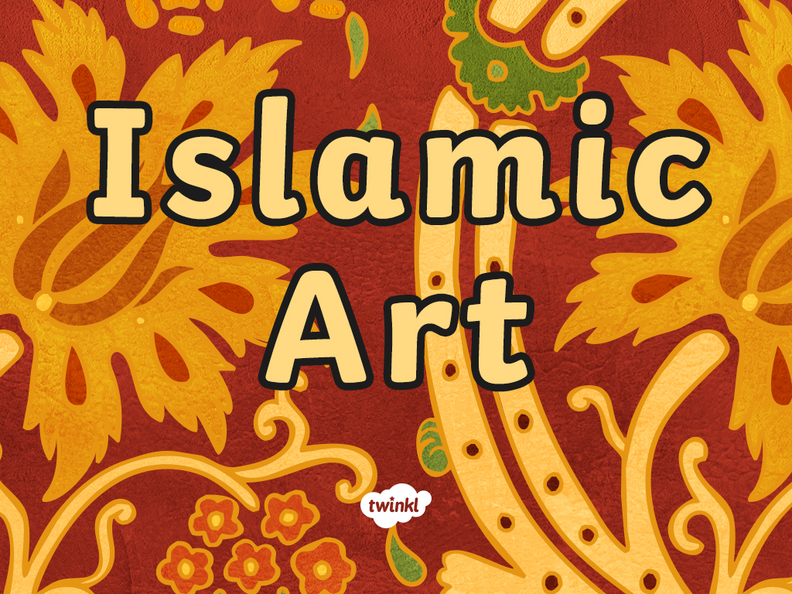

Slide 2
Aim
I can identify and talk about different forms of Islamic art and create my own geometric pattern based on traditional techniques.
Success Criteria
I can identify geometric patterns, vegetal patterns and calligraphy in different examples of Islamic art.
I can identify and explain where different forms of Islamic art was used.
I can create my own early Islamic style geometric pattern.

Slide 3
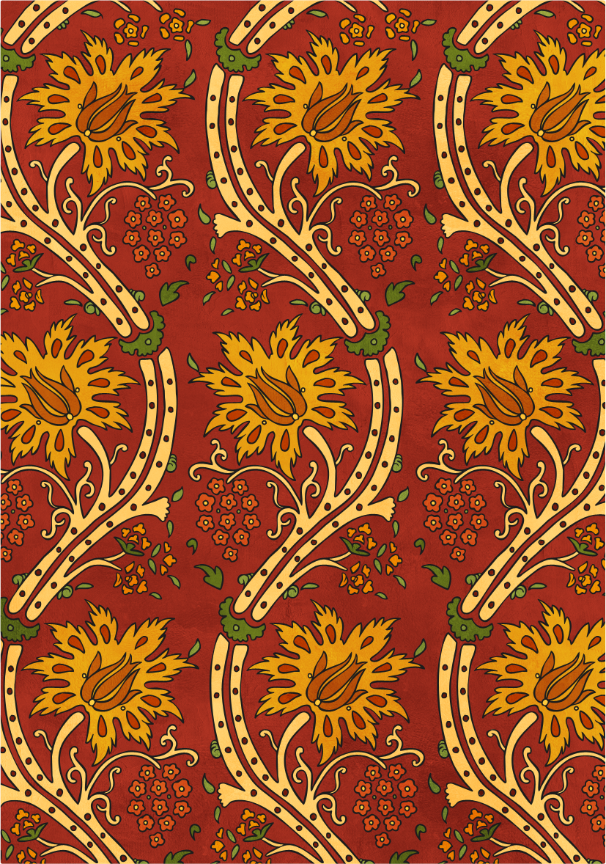
Islamic Art
What do you think of when you hear the term Islamic art?
What patterns or pictures come to mind?
Where do you think you might see examples of Islamic art?
Talk to the other children in your group and jot down your ideas.
Can you include any patterns or pictures that you have seen?

Slide 4
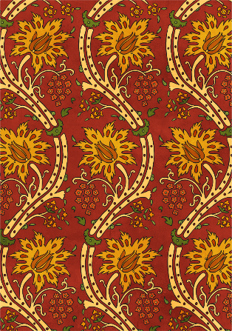
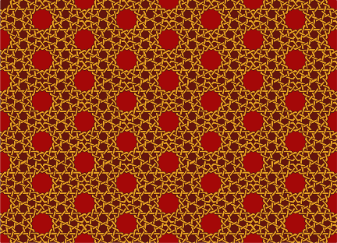
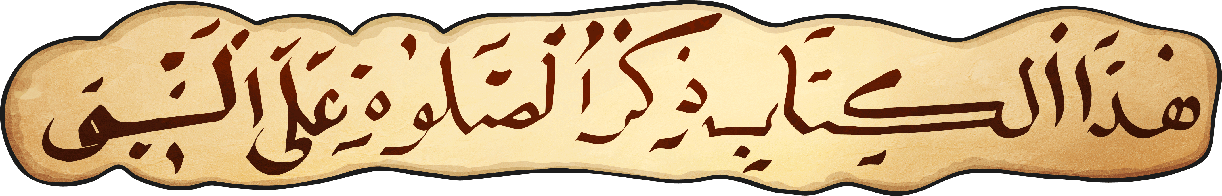
Forms of Islamic Art
The term Islamic art represents all art created in the Islamic empire which was vast and varied in terms of style. As Islam spread across the world, art and culture from those places were incorporated into Islamic art and design. This means that in the early days, Islamic art was built upon the styles and techniques of a wide range of earlier artistic forms, such as those developed under Byzantine or Sasanian rule.
It was during the Umayyad dynasty (AD 661 – 750) that an artistic style which could be clearly defined as Islamic began to develop.
Some forms of Islamic art are shown below. These art forms could be used on their own or in combination with each other.
Islamic calligraphy
Geometric patterns
Vegetal patterns

Slide 5
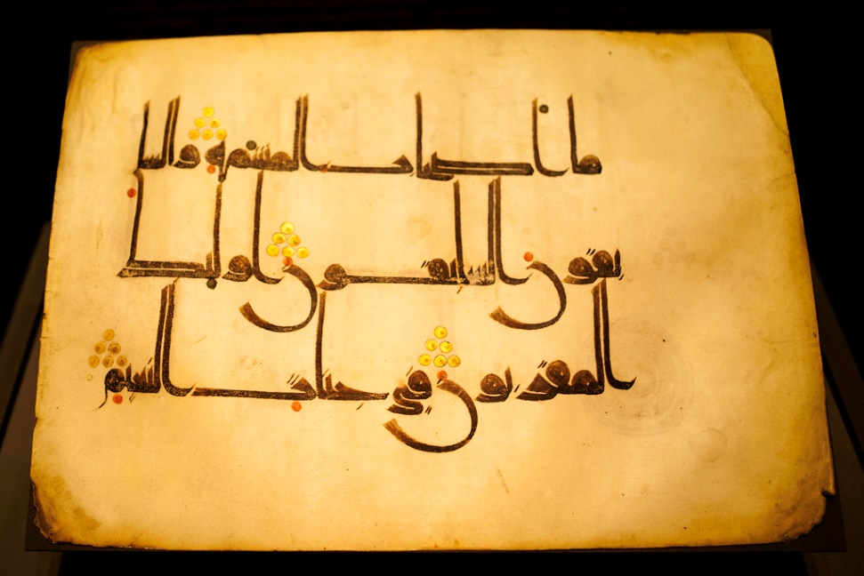
Forms of Islamic Art
Calligraphy
Calligraphy, which is a form of artistic writing, allowed early Islamic artists to communicate a text in a decorative form. Calligraphy in the early Islamic civilisation was used to decorate many different items including manuscripts, clothing, pottery, buildings and armour. The photo on the right shows a page from the Qur’an, which is written using calligraphy.
Photo courtesy of jikatu (@flickr.com) - granted under creative commons licence - attribution

Slide 6
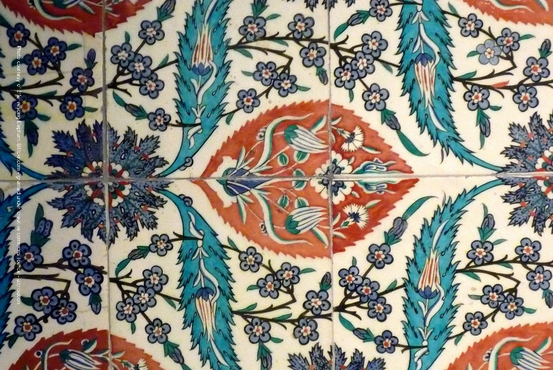
Forms of Islamic Art
Vegetal Patterns
These semi-natural patterns used in early Islamic art decorated buildings, textiles, pottery and manuscripts. The patterns are based on plants and flowers found in the natural world.
Islamic Vegetal patterns feature Arabesque (meaning ‘in the Arab fashion’ in French) patterns consisting of foliage and flowers in a linear pattern.
Photo courtesy of Effervescing Elephant (@flickr.com) - granted under creative commons licence - attribution

Slide 7
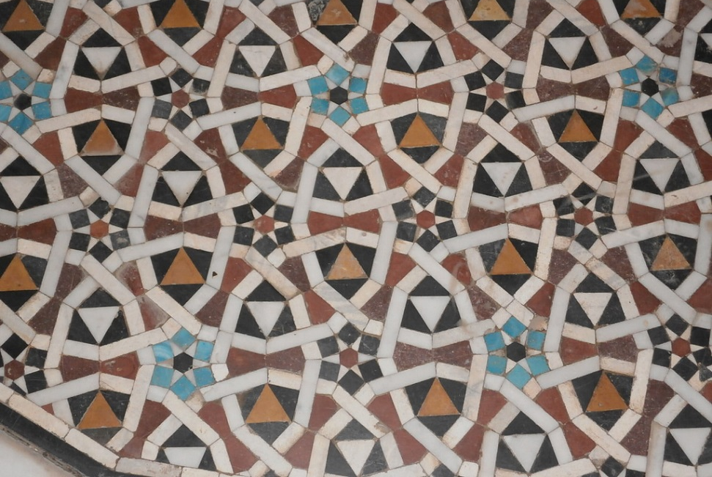
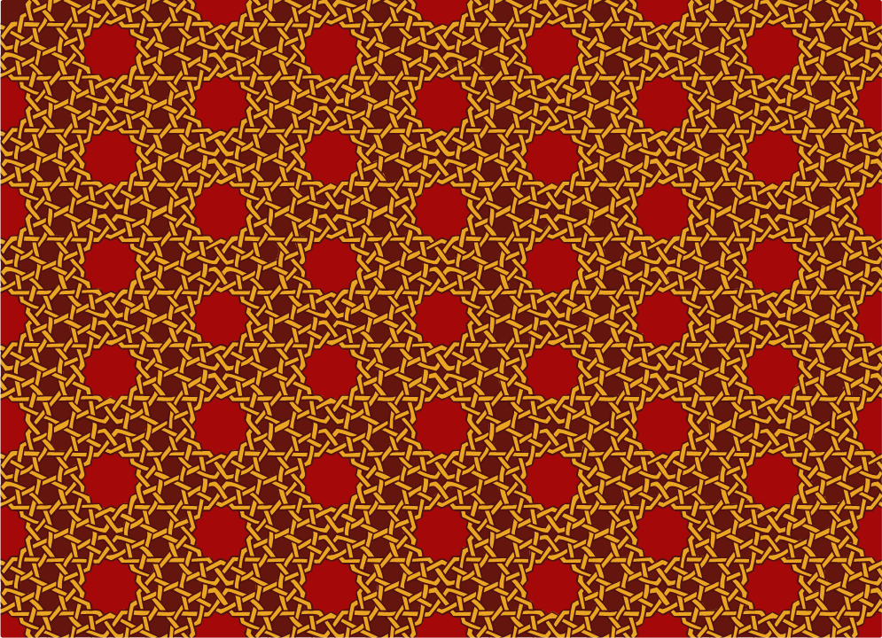
Forms of Islamic Art
Geometric Patterns
Geometric patterns were very popular in the early Islamic civilisation and they decorated everything from clothing to mosques. Geometric patterns could be used on their own or combined with calligraphy or vegetal patterns to form more complex artwork.
Geometric patterns consist of repeating, interlaced or overlapped shapes arranged in complex, intricate patterns.
Photo courtesy of mark muehlhaeusler (@flickr.com) - granted under creative commons licence - attribution

Slide 8
People and Animals
It is rare for Islamic art to contain images of people or animals.
Some believe that it is completely forbidden to even make or draw these images so that people aren’t tempted to worship anything other than God.
However, others argue that The Qu’ran doesn’t actually forbid the making of figures, statues or images of people or animals as long as they are not worshipped.

Slide 9
Presenting Our Patterns
Can you explain how you created your design?
Where can you imagine your geometric pattern being used?

Slide 10
Aim
I can identify and talk about different forms of Islamic art and create my own geometric pattern based on traditional techniques.
Success Criteria
I can identify geometric patterns, vegetal patterns and calligraphy in different examples of Islamic art.
I can identify and explain where different forms of Islamic art was used.
I can create my own early Islamic style geometric pattern.

Slide 11


