Slide 1
Instructions
Complete all tasks.
Email your work to your class teacher to get the correct answers.
Keep a copy of your work so Mr Mattaliano can check it once we are back in school.

Slide 2
Click on the link below, watch the video and listen to the right pronunciation of the months of the year in Spanish.
Los meses del año
(the months of the year)
https://www.youtube.com/watch?v=IKznbHvPFwc

Slide 3
Now please complete worksheet 3

Slide 4
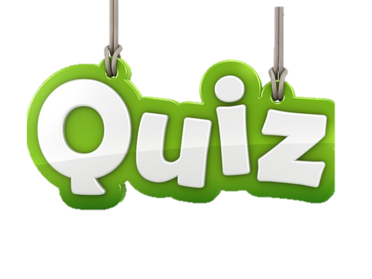
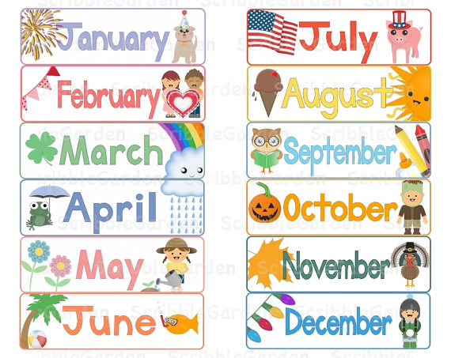
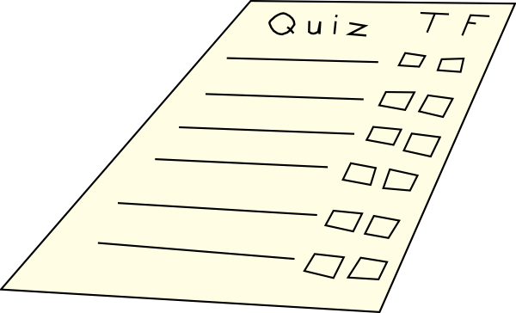
Months
Quiz
Are you ready to answer some questions?

Slide 5
Now please complete worksheet 4

Slide 6
1
Worksheet 4 – Moths Quiz

Slide 7
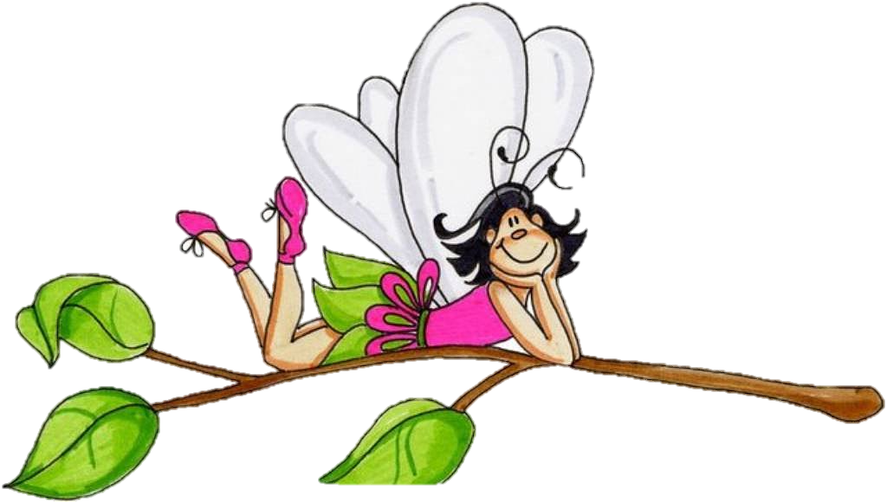
1 - What is the Spanish word for June?
A – junio
B – julio
C – agosto

Slide 8
2

Slide 9
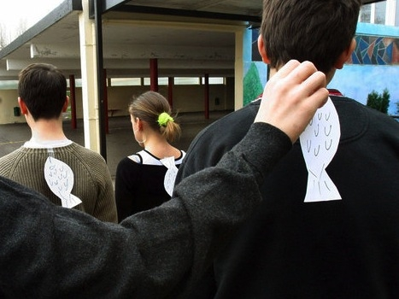
2 – On the 1st of which month do we play pranks on each other?
A – marzo
B – abril
C – mayo

Slide 10
3

Slide 11
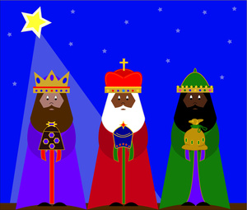
3 – In which month do the Spanish celebrate El Día de los Reyes (The Three Kings’ Day)?
A – enero
B – febrero
C – marzo

Slide 12
4

Slide 13
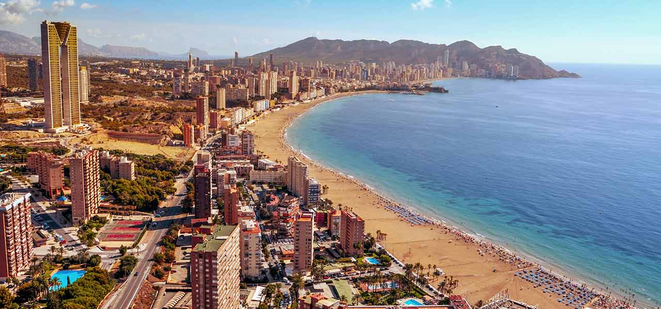
4 – In which month do lots of people go on holiday to Spain?
A – marzo
B – agosto
C – octubre

Slide 14
5

Slide 15
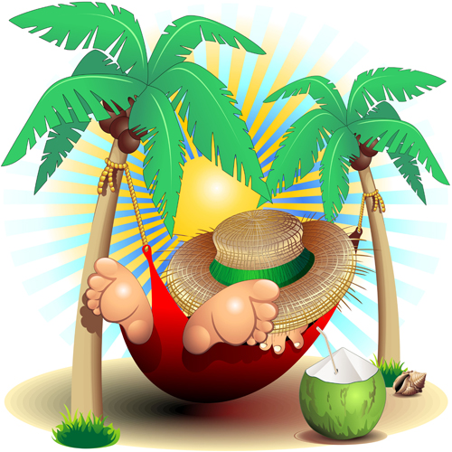
5 – In which month do we have no homework?
A – agosto
B – septiembre
C - octubre

Slide 16
6

Slide 17
6 – When is Valentine’s Day?
A – febrero
B – marzo
C – abril

Slide 18
7

Slide 19
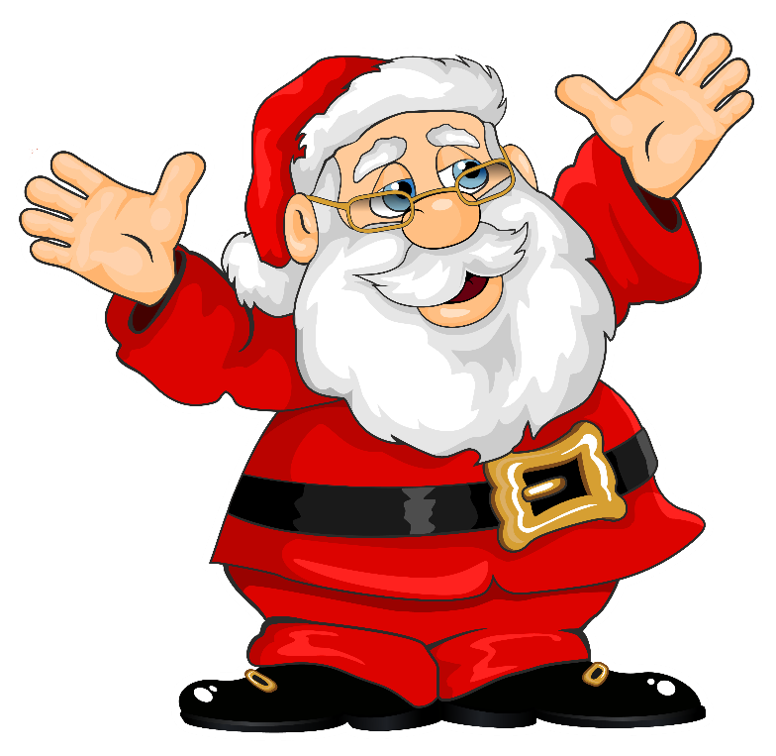
7 – When does Father Christmas visit and bring us lots of presents?
A – noviembre
B – diciembre
C – enero

Slide 20
8

Slide 21
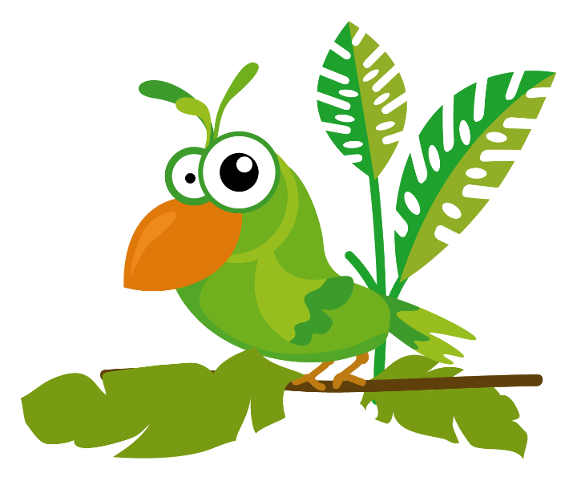
8 - What is the Spanish word for May?
A – marzo
B – abril
C – mayo

Slide 22
9

Slide 23
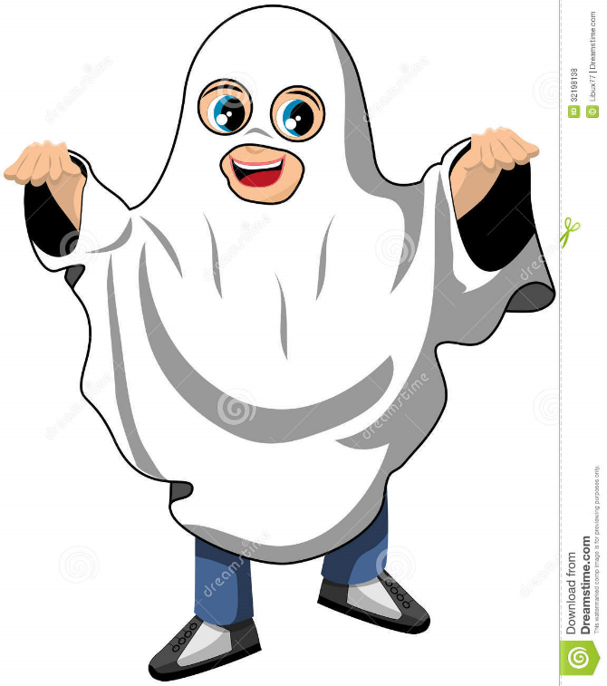
9 – In which month do children dress in scary costumes?
A – septiembre
B – octubre
C – noviembre

Slide 24
10

Slide 25
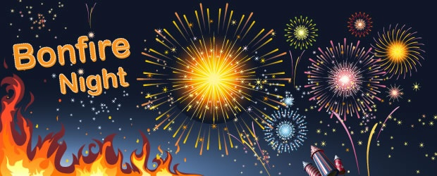
10 – When is Bonfire Night?
A – 3 noviembre
B – 4 noviembre
C – 5 noviembre

