Slide 2
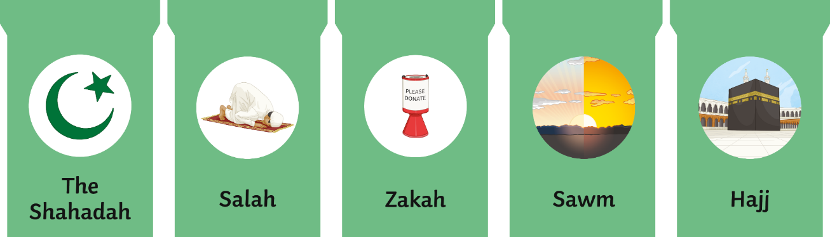
What Are the Five Pillars of Islam?
The Five Pillars of Islam are five duties that all Muslims are expected to try to carry out. They do this to live good and responsible lives as well as become closer to God (Allah) and their community.
The Five Pillars are:
Zakat
(prayer)
(charity)
(fasting)
(pilgrimage)

Slide 3
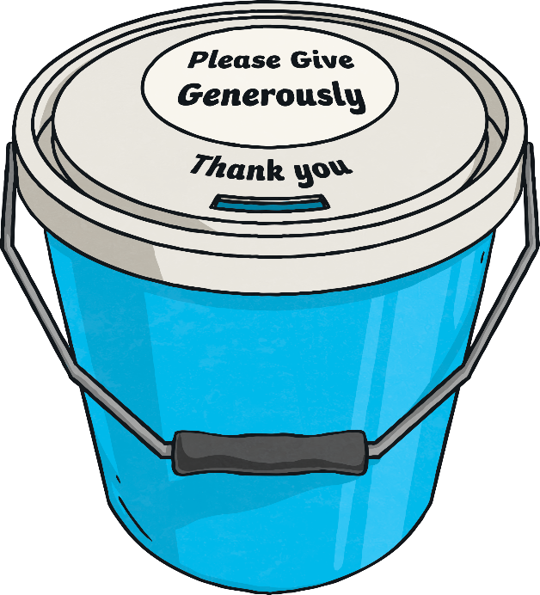
Helping Others
There are two types of Zakat and both are obligatory - Zakat ul-Mal and Zakat ul-Fitr.
Zakat ul-Mal, the third pillar of Islam, is all about looking after others.
Every year, Muslims give up a share of their savings to help those in need. It is thought that when someone helps another in this way, they become cleansed from selfishness and greed.
Many Muslims give donations of money to different charities around the world.

Slide 4

Zakat ul-Mal
This compulsory charity contribution must be made by all Muslims who have a certain level of wealth, also known as the Nisab.
The Nisab is calculated based on the value of three ounces of pure gold at the time. At the time of writing, the gold Nisab is £3,787.88.
If your total savings reach (or exceed) the Nisab level (the value of three ounces of pure gold), you have to pay Zakat (2.5%) of the total amount of your savings, every lunar year.
There are online Zakat calculators to help you to work out how much you must pay.
Will everyone donate the same amount?
Discuss It

Slide 5
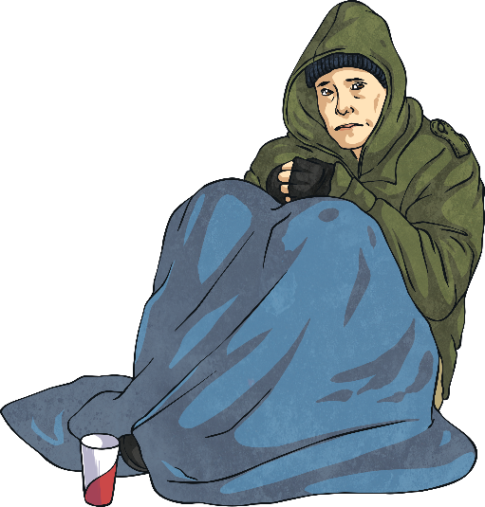
Who Does It Help?
There are eight groups of people to whom Zakat ul-Mal can be given.
The poor
Those who live in poverty with not enough money to buy daily necessities, such as food and clothing.
The needy
Those who don’t own anything or receive an income.
Zakat collectors
Authorised collectors, who give out the money to the poor and needy.
Those who have converted to Islam
If someone who has converted to Islam is needy, they can receive financial support.

Slide 6
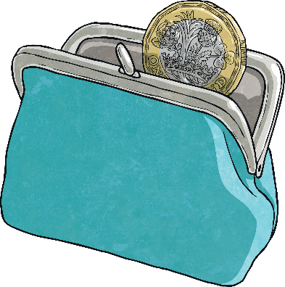
Who Does It Help?
Freeing those who are enslaved
It can help enslaved people to free themselves.
Debtors
Given to those who are in debt and unable to pay.
In the path of Allah (God)
Those who are fighting for Allah’s cause.
Travellers
Refugees can be given money to help them to escape violence in their country.

Slide 7
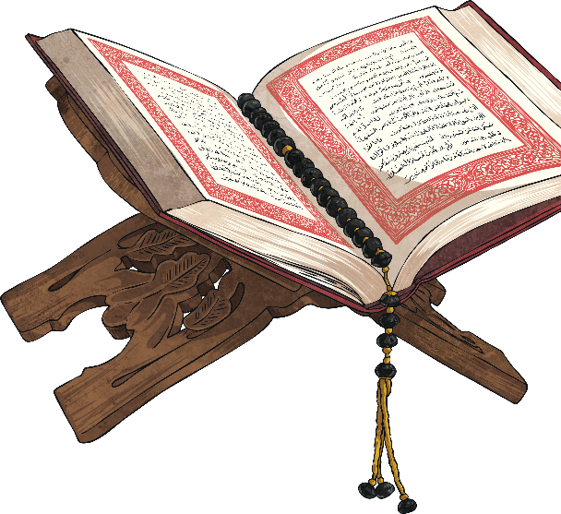
Zakat ul-Fitr
Zakat ul-Fitr is different to Zakat ul-Mal. Zakat ul-Fitr is the donation of food made during the month of Ramadan. All adult Muslims, who have food to spare, donate their food at this time.
During Ramadan, Muslims (from the age of around 14) don’t eat or drink during daylight hours. Ramadan marks the month that the Qur’an (the Muslim holy book) was first revealed to the Prophet Muhammad (Peace Be Upon Him).
At the end of Ramadan, there is a big celebration called Eid al-Fitr. Muslims wear their best clothes and spend time with family and friends.

Slide 8
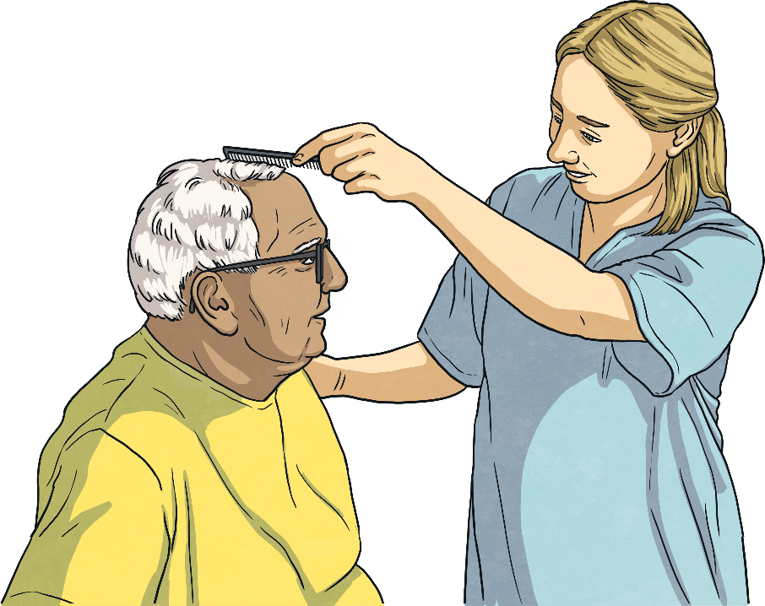
Final Thoughts
Do you donate items, money or your time to help others?

