Slide 1
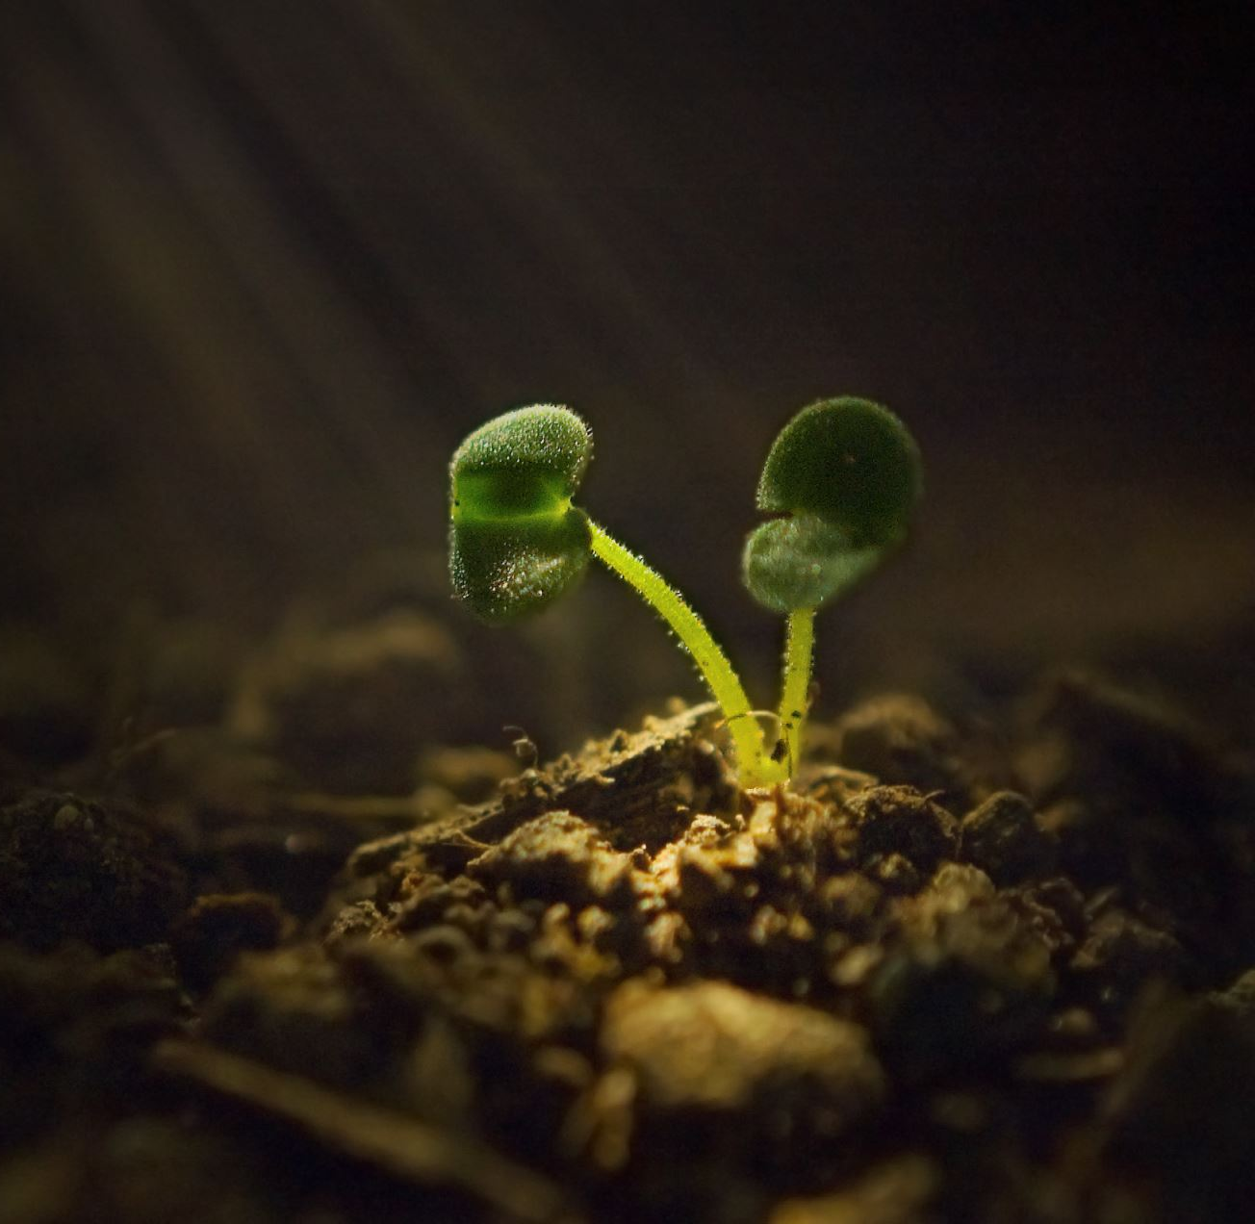
The seed song

Slide 2
Find a little seed (Find a little seed),
Plant it in the ground (Plant it in the ground),
Wait for it to grow (Wait for it to grow),
Don’t disturb it!

Slide 3
Don’t expect to see (Don’t expect to see),
Changes over night (Changes over night),
If you want a while (If you wait a while),
You’ll find new life!

Slide 4
Sunshine will come,
Raindrops will fall,
Your little seed will grow again.
Soon there will be a day in Spring when
Your seed blossoms and grows.

Slide 5
Find seed of love (Find a seed of love),
Plant it where you can (Plant it where you can),
Wait for it to grow (Wait for it to grow),
Don’t disturb it!

Slide 6
Don’t expect to see (Don’t expect to see),
Changes over night (Changes over night),
If you want a while (If you wait a while),
You’ll find new life!

Slide 7
Sunshine will come,
Raindrops will fall,
Your little seed will grow again.
Soon there will be a day in Spring when
Your seed blossoms and grows.

Slide 8
Sunshine will come,
Raindrops will fall,
Your little seed will grow again.
Soon there will be a day in Spring when
Your seed blossoms and grows.
….. And that’s that!

