Slide 2





/l/ Spelt ‘-il’
We have looked at the sound /l/ spelt with ‘-le’ and ‘-el’ at the end of words.
The /l/ sound at the end of these words is spelt with ‘-il’ instead.
pencil
fossil
nostril
pupil

Slide 3
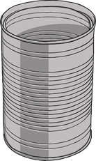
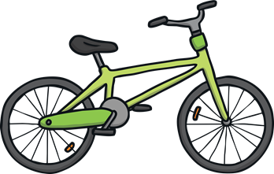
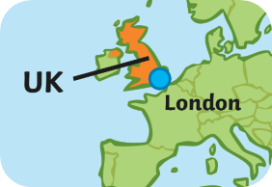

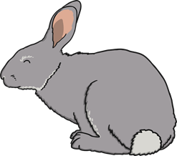

/l/ Spelt ‘-al’
There is another way to spell the /l/ sound.
The /l/ sound at the end of these words is spelt with ‘-al’ instead.
metal
pedal
capital
oval
hospital
animal

Slide 4
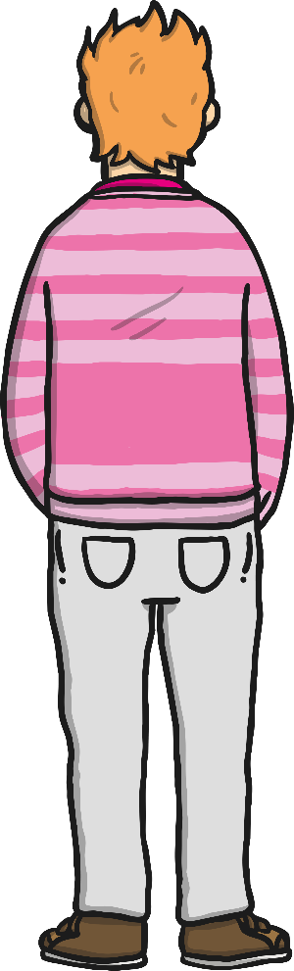






/l/ Spelt ‘-il’ and ‘-al’
Can you air write an ‘il’ with your finger?
Can you write either an ‘il’ or an ‘al’ on a partner’s back?
Can you write an ‘-al’ on the back of your hand?
Can they tell
what letters you have written?

Slide 5
Here are this week’s spellings to practise.
pencil
fossil
nostril
pupil
metal
pedal
capital
hospital
animal
oval

