Slide 2
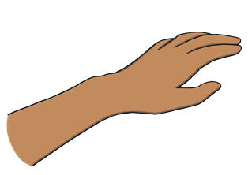
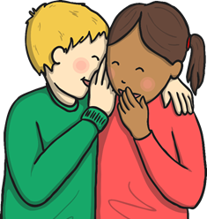



Verbs and Nouns
A noun is a person, place, thing or object.
A verb is a doing word (an action).
Can you think of a noun that ends in ‘-y’ and whisper it to
a partner?
Can you think of a verb that ends in ‘-y’ and write it on your arm?

Slide 3
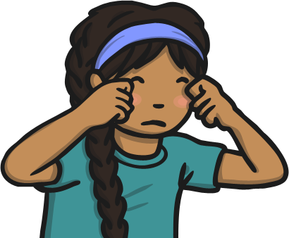
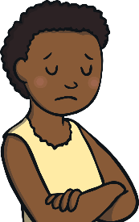
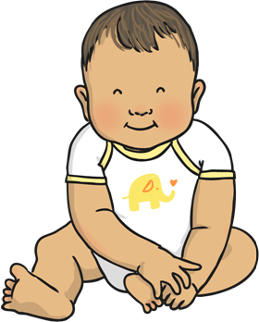

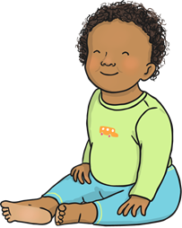
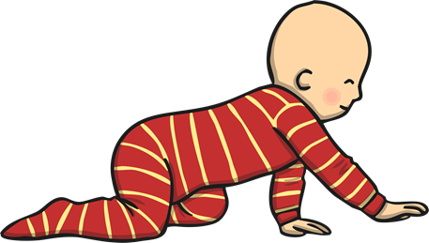
Changing ‘-y’ to ‘-es’
We have learnt about words ending in ‘-y’. Sometimes verbs and nouns need to change their spelling. Look at how these verbs and nouns change in these sentences.
I cry at sad films.
Mum cries at sad films.
What a sweet baby!
What a lot of sweet babies!
A noun or verb ending in ‘-y’ is changed to ‘-ies’ for plurals, or when the word needs to change to make sense.

Slide 4

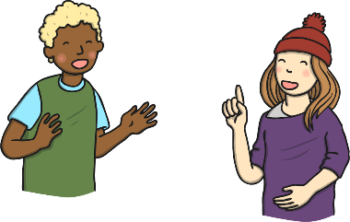

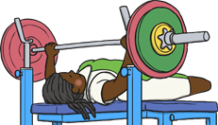
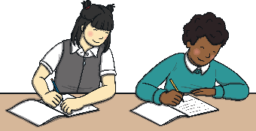


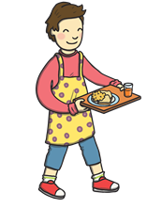
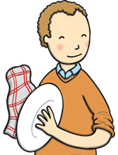

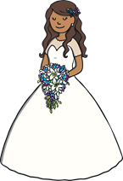

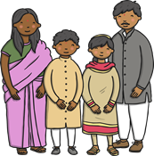
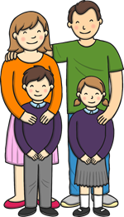
Changing ‘-y’ to ‘-es’
One way to think about the rule could be:
The ‘y’ is changed to ‘i’ before ‘–es’ is added.
flies
tries
replies
copies
babies
carries
cries
dries
marries
families

Slide 5
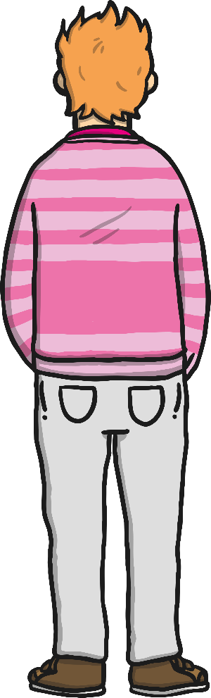

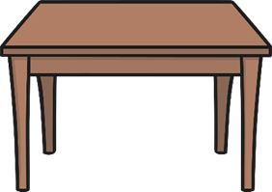

Changing ‘-y’ to ‘-es’
One way to think about the rule could be:
The ‘y’ is changed to ‘i’ before ‘–es’ is added.
Can you write an ‘ies’ on your table or the carpet?
Can you write either
a word ending in
‘-y’ or ‘-ies’ on a partner’s back?
Can you air write a ‘y’ with your finger and then cross it out, changing it to ‘ies’?
Can they tell
what word you have written?

Slide 6
Here are this week’s spellings to practise.
flies
tries
replies
copies
babies
carries
cries
dries
marries
families

