Slide 1
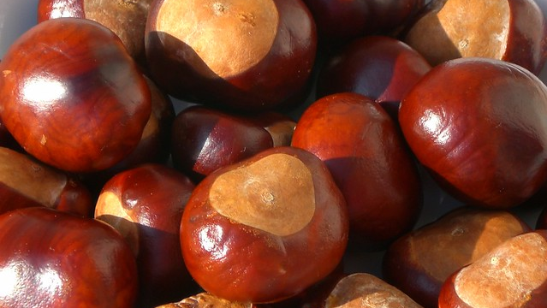
Conkers
This Photo by Unknown author is licensed under CC BY.

Slide 2
Conkers! I’m collecting conkers,
I’m trying hard to find the biggest and the best.
Conkers! Lots of lovely conkers,
I want a conker that is better than the rest.

Slide 3
Under the chestnut tree,
There waits for me,
A sight so marvellous to behold.
Amidst the Autumn leaves,
It gleams at me,
A conker, beautiful and bold.

Slide 4
Conkers! I’m collecting conkers,
I’m trying hard to find the biggest and the best.
Conkers! Lots of lovely conkers,
I want a conker that is better than the rest.

Slide 5
Under the chestnut tree,
Where no one’s been,
The spiky shells lie on the ground.
Beneath their armour green,
There hides unseen,
A conker, smooth and shiny brown.

Slide 6
Conkers! I’m collecting conkers,
I’m trying hard to find the biggest and the best.
Conkers! Lots of lovely conkers,
I want a conker that is better than the rest.

Slide 7
Under the chestnut tree,
I stretch to see,
A final conker to be mine.
If I can only reach,
To pull it free,
I’ll add it to my ninety-nine.
ONE HUNDRED!

Slide 8
Conkers! I’m collecting conkers,
I’m trying hard to find the biggest and the best.
Conkers! Lots of lovely conkers,
I think I’ve found that special one to beat the rest!
Conkers! Lots of lovely conkers!
Conkers! Lots of lovely conkers!

