Slide 1
Big family of God
Lyrics (play the online song and show these words)

Slide 2


Some of us are big and tall
Some of us are very small
Some of us like pink and some like blue
Some of us like reading books
Some of us like feeding ducks
That’s because we’re different, me and you

Slide 3
But God loves everyone he’s made
God loves each of us, in a special way
That’s You and You and You and You
And You and You and You and You
God loves you! God loves you!
That’s You and You and You and You
And You and You and You and You
We’re part of the big family of God!

Slide 4
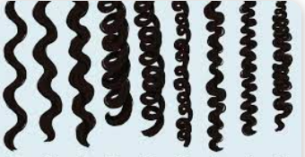
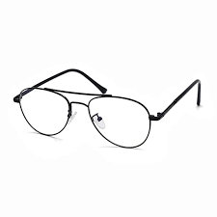
Some of us have curly hair,
Some of us have specs to wear
All of us have different families
Some of us are very loud
Some of us don’t make a sound
That’s because we’re different you and me

Slide 5
But God loves everyone he’s made
God loves each of us, in a special way
That’s You and You and You and You
And You and You and You and You
God loves you! God loves you!
That’s You and You and You and You
And You and You and You and You
We’re part of the big family of God! (sing 4x)

Slide 6
But God loves everyone he’s made
God loves each of us, in a special way
That’s You and You and You and You
And You and You and You and You
God loves you! God loves you!
That’s You and You and You and You
And You and You and You and You
We’re part of the big family of God! (sing 5x)

